Slide 1

Formal Specification of Data-Oriented Systems
Gabriele Taentzer

Slide 2
Overview
How can data-oriented systems be formally specified?
  Graphs define states
  Graph transformations define transitions
  Graph transition systems define transition systems in which every state is a graph and every transition is a graph transformation.
Notes:
The general problem: states are only blobs.

Slide 3
Modelling data structures with graphs
Graphs can be used to model various data structures.
  For example: lists, stacks and trees
Graph node
  Labels distinguish different types of nodes.
  Labels also hold additional information.
Graph edges
  Edges specify relations between nodes.
  Edge labels can distinguish different kinds of edges.

Slide 4
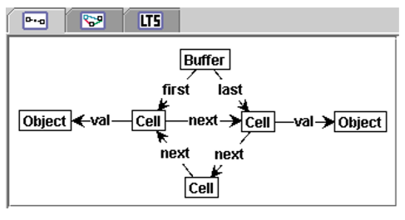
Example: A circular buffer
Producer-consumer problem with buffer:
  The buffer has n cells, which are arranged in a ring shape. These may be filled with values one after the other and emptied in reverse order.
  The buffer may also be extended by cells.
  Advantage over a queue: No shifting of elements, access in constant time
[KR06]
A buffer with three cells, two of which are occupied.

Slide 5
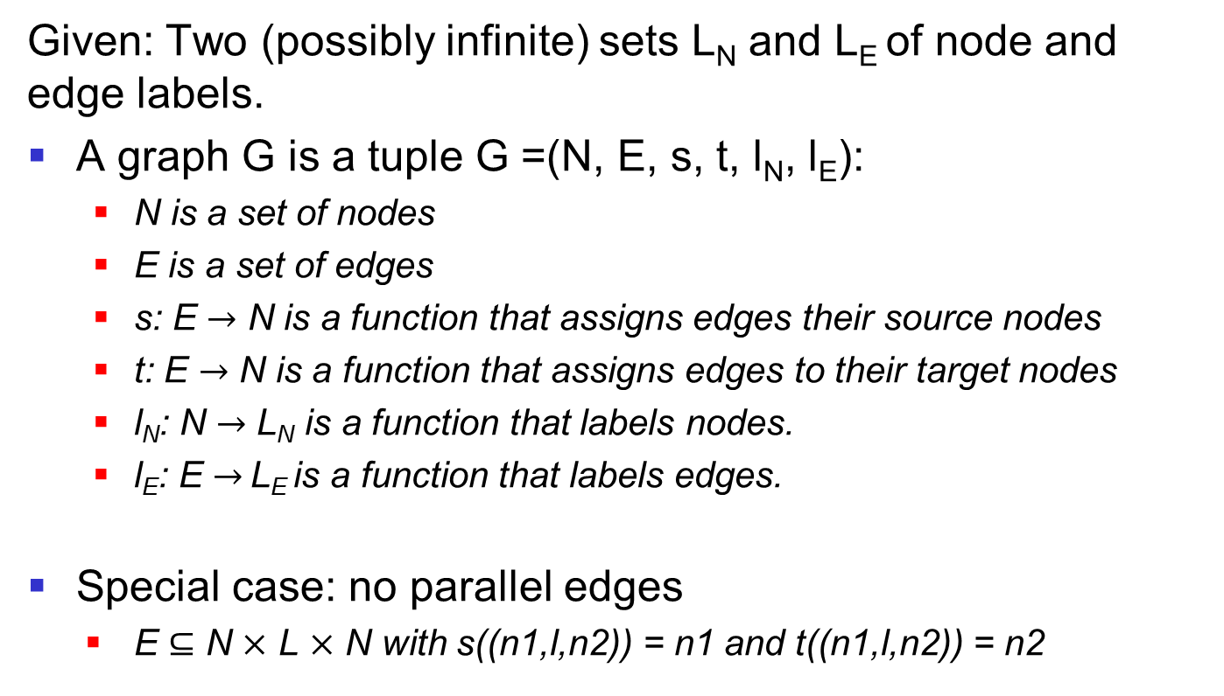
Definition: Graph
Given: Two (possibly infinite) sets L_{N} and L_{E} of node and edge labels.
A graph G is a tuple G =(N, E, s, t, l_{N}, l_{E}):
  N is a set of nodes
  E is a set of edges
  s: E $→$ N is a function that assigns edges their source nodes
  t: E $→$ N is a function that assigns edges to their target nodes
  l_{N}: N $→$ L_{N} is a function that labels nodes.
  l_{E}: E $→$ L_{E} is a function that labels edges.
Special case: no parallel edges
  E $⊆$ N $×$ L $×$ N with s((n1,l,n2)) = n1 and t((n1,l,n2)) = n2
Notes:
Formally represent circular graphs
Graphs with parallel edges:
multi set as nodes, edges for the occurrences of elements
cube throws
Drawing balls from an urn and the balls are put back
DBS: Tables can have identical entries

Slide 6
Modelling of structural changes
Graph changes are specified based on rules.
Each rule defines an action on state graphs.
A graph rule r = (L, R, NAC) consists of
  a left-hand side L
  a right-hand side R and
  a set of negative application conditions NAC, each comprising the left-hand side of the rule.

Slide 7
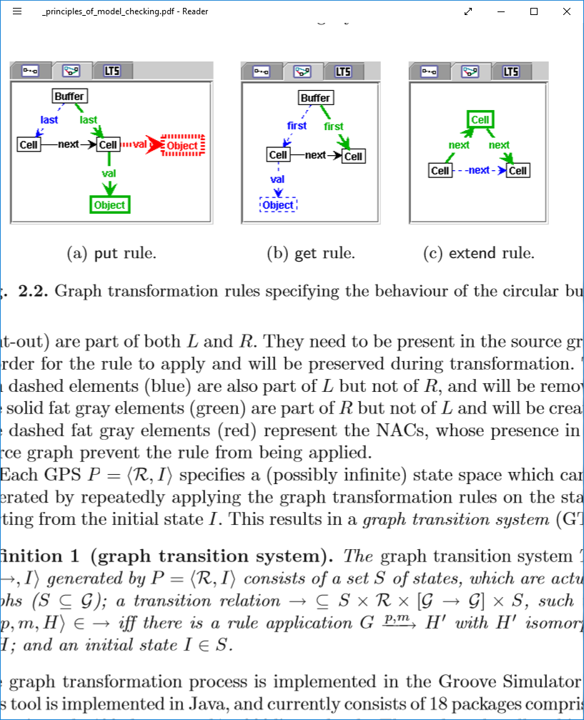
Example: A circular buffer
Rule-based specification of actions
  Black: structural components to be preserved
  Blue: structural parts to be deleted
  Red: prohibited structural parts
  Green: structural components to be created
[KR06]

Slide 8
Graph rule
Rule-based specification of actions
  Left-hand side:
    Black: graph part to be preserved
    Blue: graph part to be deleted
  Right-hand side:
    Black: graph part to be preserved
    Green: graph part to be created
  Negative application condition:
    Left-hand side
    Red: prohibited structural parts
[KR06]
Notes:
Show separate notation

Slide 9
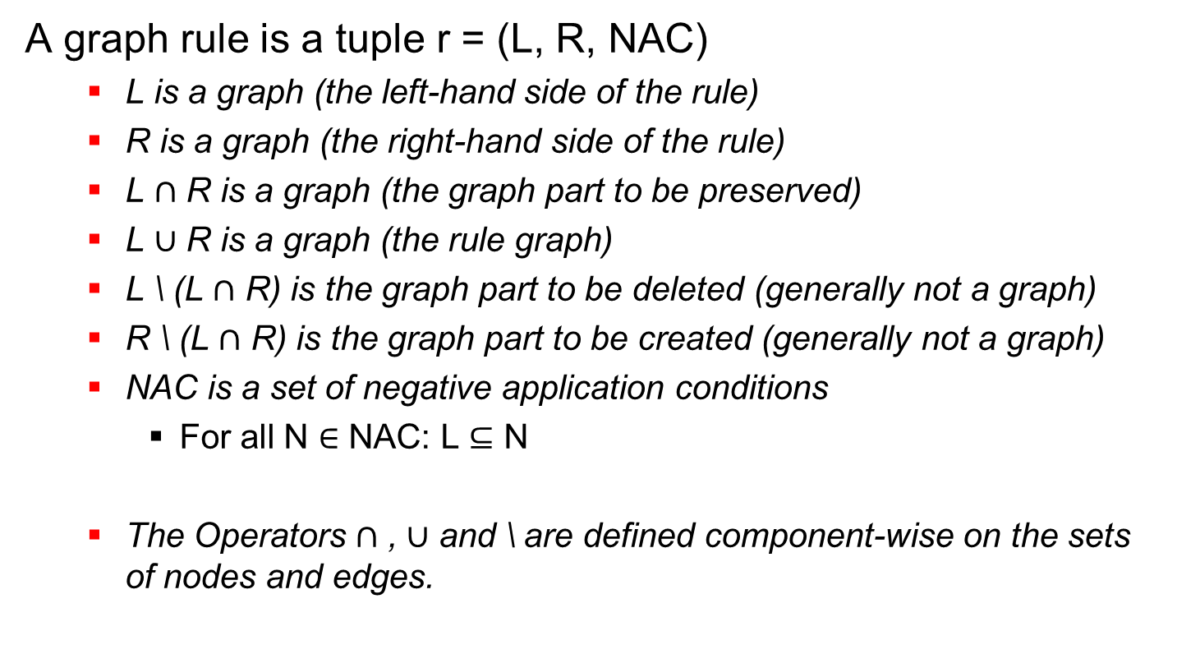
Definition: Graph Rule
A graph rule is a tuple r = (L, R, NAC)
  L is a graph (the left-hand side of the rule)
  R is a graph (the right-hand side of the rule)
  L $∩$ R is a graph (the graph part to be preserved)
  L $∪$ R is a graph (the rule graph)
  L \ (L $∩$ R) is the graph part to be deleted (generally not a graph)
  R \ (L $∩$ R) is the graph part to be created (generally not a graph)
  NAC is a set of negative application conditions
    For all N $∈$ NAC: L $⊆$ N
  The Operators $∩$ , $∪$ and \ are defined component-wise on the sets of nodes and edges.
Notes:
To show:
1. L cut R is not always a graph
2. l u R is a graph, well defined if L is cut R is a graph

Slide 10
Application of a rule
Given: a graph G and a rule r = (L,R,NAC)
The rule r is applicable to G if
  L can be mapped to a subgraph of G,
  all conditions in NAC are met for this mapping, and
  the deletion of the graph elements to be deleted does not leave dangling edges.
The application of r to G produces a graph H, which is obtained as follows:
  From G, the graph elements to be deleted are deleted and
  the graph elements to be created are added.

Slide 11
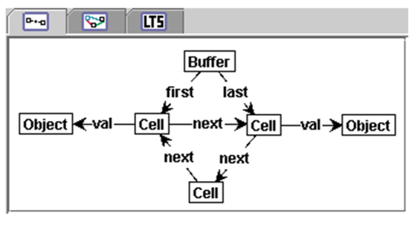
Example: Rule application
Rule get:
Graph G:
Graph H:
Notes:
Examples of control applications with hanging edges and unfulfilled NAC

Slide 12
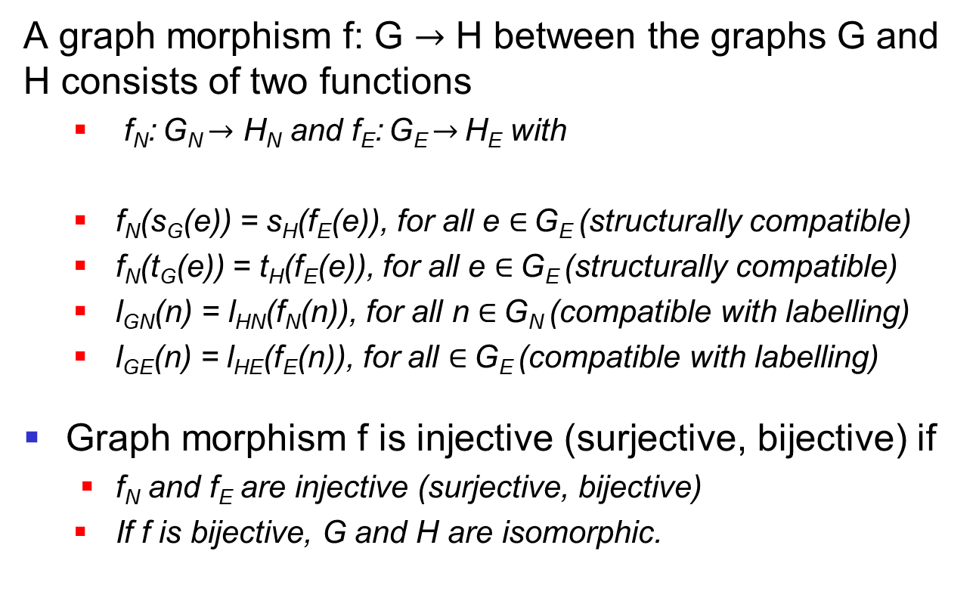
Definition: Graph morphism
A graph morphism f: G $→$ H between the graphs G and H consists of two functions
  f_{N}: G_{N} $→$ H_{N} and f_{E}: G_{E} $→$ H_{E} with
  f_{N}(s_{G}(e)) = s_{H}(f_{E}(e)), for all e $∈$ G_{E} (structurally compatible)
  f_{N}(t_{G}(e)) = t_{H}(f_{E}(e)), for all e $∈$ G_{E} (structurally compatible)
  l_{GN}(n) = l_{HN}(f_{N}(n)), for all n $∈$ G_{N} (compatible with labelling)
  l_{GE}(n) = l_{HE}(f_{E}(n)), for all $∈$ G_{E} (compatible with labelling)
Graph morphism f is injective (surjective, bijective) if
  f_{N} and f_{E} are injective (surjective, bijective)
  If f is bijective, G and H are isomorphic.
Notes:
Examples and counterexamples for graphmorphisms
Composition of graphmorphisms:
f: G -> H, g: H -> K, gN o fN: GN -> KN
For all e in GE: gN o fN(sG(e )) = gN(fN(sG( e ))) = gN(sH(fE( e ))) = sK(gE(fE( e ))) = sK(gE o fE( e ))

Slide 13
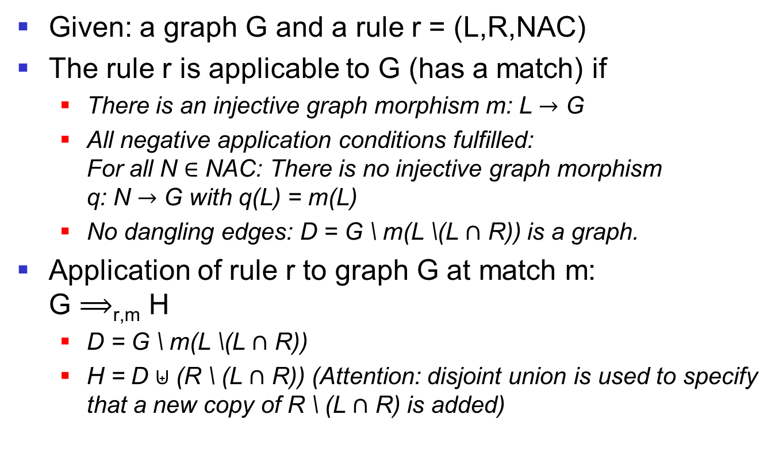
Definition: Application of a rule
Given: a graph G and a rule r = (L,R,NAC)
The rule r is applicable to G (has a match) if
  There is an injective graph morphism m: L $→$ G
  All negative application conditions fulfilled: For all N $∈$ NAC: There is no injective graph morphism q: N $→$ G with q(L) = m(L)
  No dangling edges: D = G \ m(L \(L $∩$ R)) is a graph.
Application of rule r to graph G at match m: G $⟹$_{r,m} H
  D = G \ m(L \(L $∩$ R))
  H = D $⊎$ (R \ (L $∩$ R)) (Attention: disjoint union is used to specify that a new copy of R \ (L $∩$ R) is added)
Notes:
To show: Disjoint union of G and H is always a graph
Is the composition of two graphmorphisms again a graphmorphism?

Slide 14
Graph Transition System
Given:
  a set R of rules and a start graph I
All possible rule applications form a transition system.
  States are specified by graphs.
  Actions are defined by rules.
  Transitions are specified by rule applications.
  I is the initial state.

Slide 15
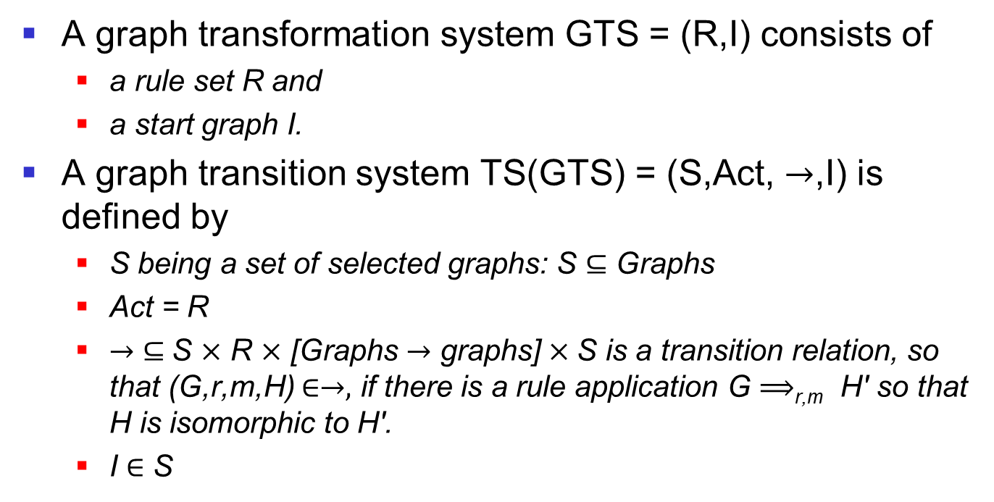
Definition: Graph Transition System
A graph transformation system GTS = (R,I) consists of
  a rule set R and
  a start graph I.
A graph transition system TS(GTS) = (S,Act, $→$,I) is defined by
  S being a set of selected graphs: S $⊆$ Graphs
  Act = R
  $→$ $⊆$S $×$ R $×$ [Graphs $→$ graphs] $×$S is a transition relation, so that (G,r,m,H) $∈→,$ if there is a rule application G $⟹$_{r,m} H' so that H is isomorphic to H'.
  I $∈$ S

Slide 16
Summary
States of data structures can be specified by labelled graphs.
Rule-based graph transformations specify allowed graph transitions.
A graph transition system specifies the state space for a given graph transformation system.
  The state space is generally infinite.

Slide 17
Literature and links
Reiko Heckel, Gabriele Taentzer: Graph Transformation for Software Engineers, Chapters 1 - 4
Harmen Kastenberg, Arend Rensink: Model Checking Dynamic States in GROOVE. SPIN 2006: 299-305
Hartmut Ehrig, Karsten Ehrig, Ulrike Prange, Gabriele Taentzer: Fundamentals of Algebraic Graph Transformation, Springer, 2006
Groove: Graphs for Object-Oriented Verification, groove.cs.utwente.nl

Slide 18
Specification of Object-Oriented Systems
Foundations of Graph Transformation
Gabriele Taentzer

Slide 19
Overview
How can object structures be specified with graphs?
  Objects as instances of classes
  Objects as encapsulation of attributes
  References between objects
How can methods be defined?
How do we deal with data types?
How can inheritance be formally defined?
  Abstract classes
  Single versus multiple inheritance
Notes:
How do we deal with polymorphism?

Slide 20
Java example for circular buffer
[ZR11]
Notes:
Object structures in graphs
Where does the initial object structure come from? Constructor
Methods describe changes to object structures > Rules

Slide 21
Typed graph transformation
A type graph defines all object and data types involved (i.e. the class structure).
The start graph defines the initial object structure
  after the initialization of essential objects.
A rule can be compared with a simple method.
  For complex methods, several controlled rule applications are generally needed.

Slide 22
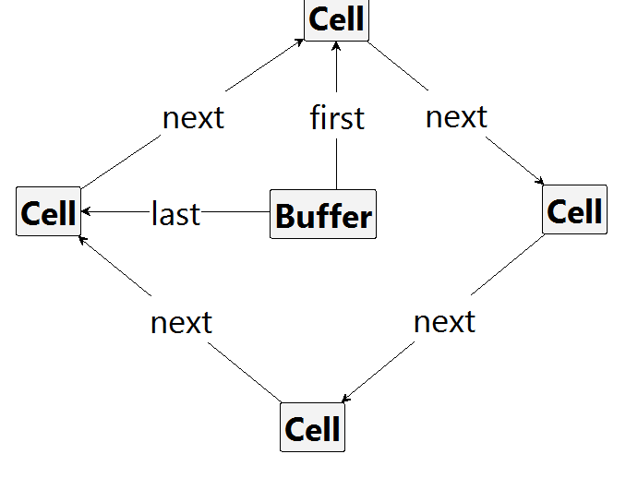
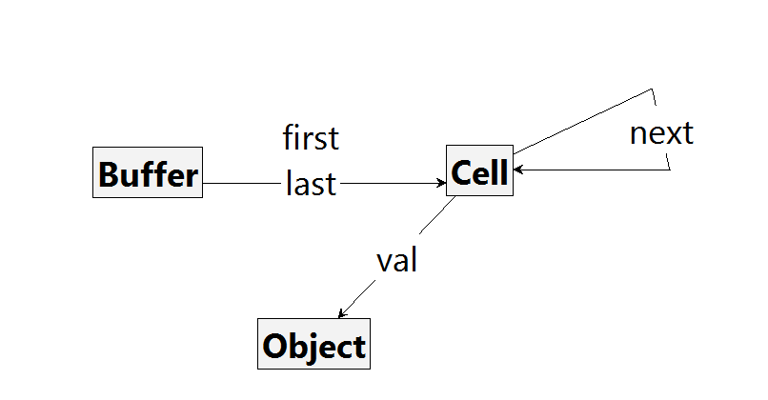
Example: typed graph
typed instance graph
type graph
Notes:
Change to buffer with only three cells.
Difference marked - typed graphs
Typification through morphism
On the panel with explicit type graph: Graph without type name
Develop graph derivation on the table, first typed, then attributed, then with inheritance

Slide 23
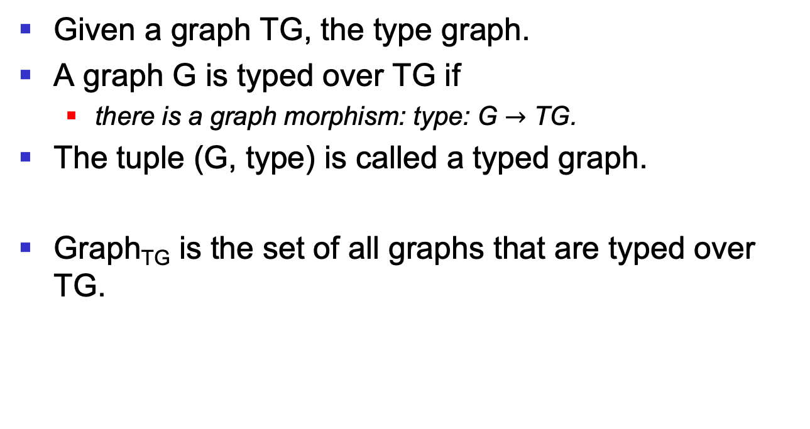
Typed graph
Given a graph TG, the type graph.
A graph G is typed over TG if
  there is a graph morphism: type: G $→$ TG.
The tuple (G, type) is called a typed graph.
Graph_{TG} is the set of all graphs that are typed over TG.
Notes:
Given TG: Search for a graph (G,type_G) typed via TG, which has a typed graph morphism in every other graph (H,type_H) typed via TG.
Search for a graph (G,type_G) typed via TG, in which every other graph (H,type_H) typed via TG has a typed graph morphism.

Slide 24
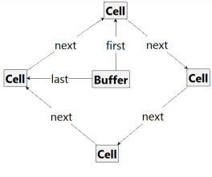
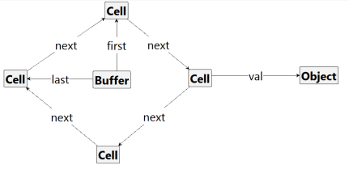
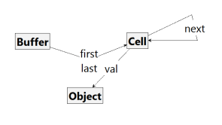
Example: Typed graph morphism
instance graph G₁
instance graph G₂
type graph
Notes:
How do we want to map typed graphs?
Type conforming

Slide 25
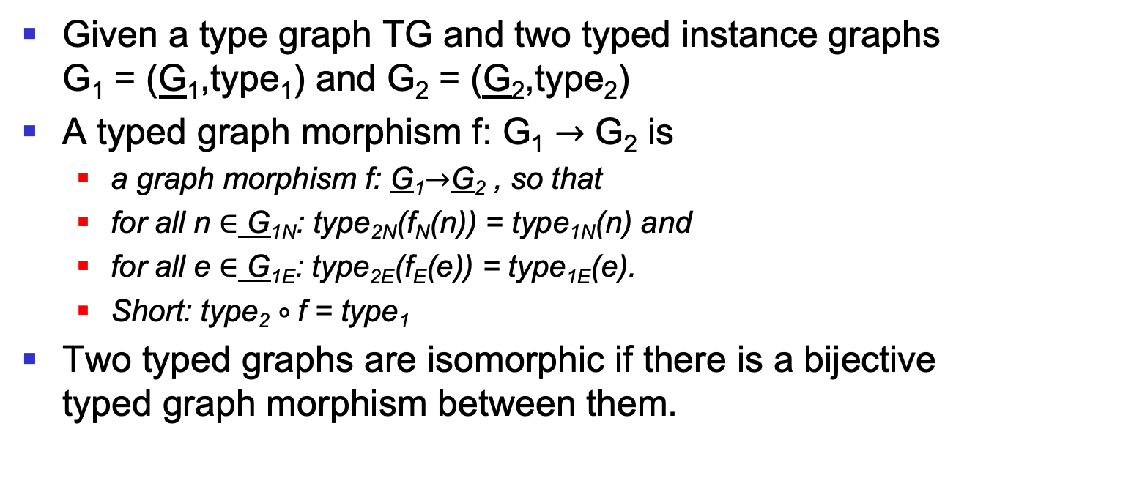
Typed graph morphism
Given a type graph TG and two typed instance graphs G₁ = (G₁,type₁) and G₂ = (G₂,type₂)
A typed graph morphism f: G₁ $→$ G₂ is
  a graph morphism f: G₁$→$G₂ , so that
  for all n $∈$ G_{1N}: type_{2N}(f_{N}(n)) = type_{1N}(n) and
  for all e $∈$ G_{1E}: type_{2E}(f_{E}(e)) = type_{1E}(e).
  Short: type₂ $∘$f = type₁
Two typed graphs are isomorphic if there is a bijective typed graph morphism between them.
Notes:
The composition of two typed graphmorphisms again results in a typed graphmorphism.

Slide 26
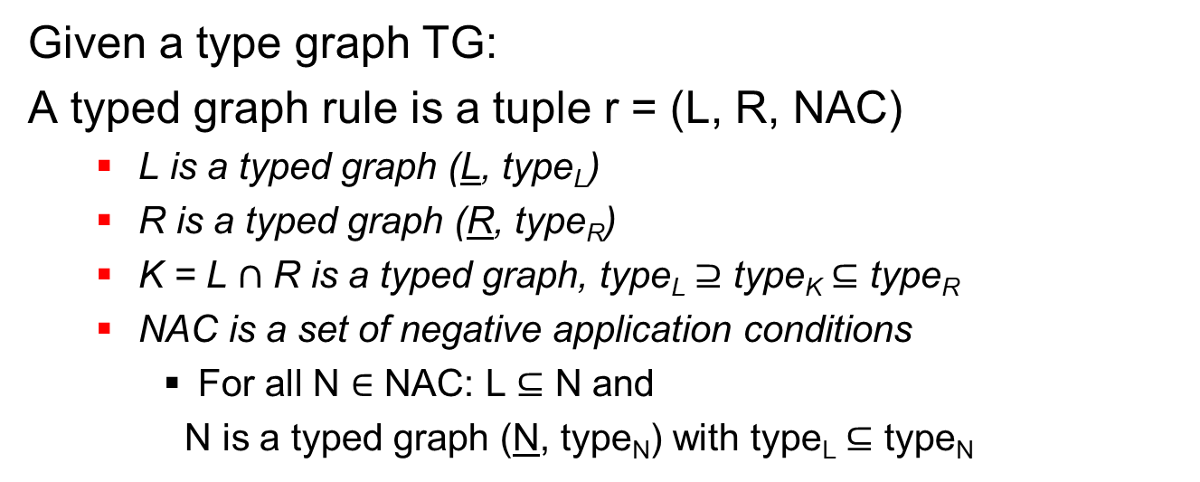
Typed graph rule
Given a type graph TG:
A typed graph rule is a tuple r = (L, R, NAC)
  L is a typed graph (L, type_{L})
  R is a typed graph (R, type_{R})
  K = L $∩$ R is a typed graph, type_{L} $⊇$ type_{K} $⊆$ type_{R}
  NAC is a set of negative application conditions
    For all N $∈$ NAC: L $⊆$ N and
    N is a typed graph (N, type_{N}) with type_{L} $⊆$ type_{N}
[KR06]
Notes:
The typing on the cut of L and R must match.
The typing of N must extend that of L.

Slide 27
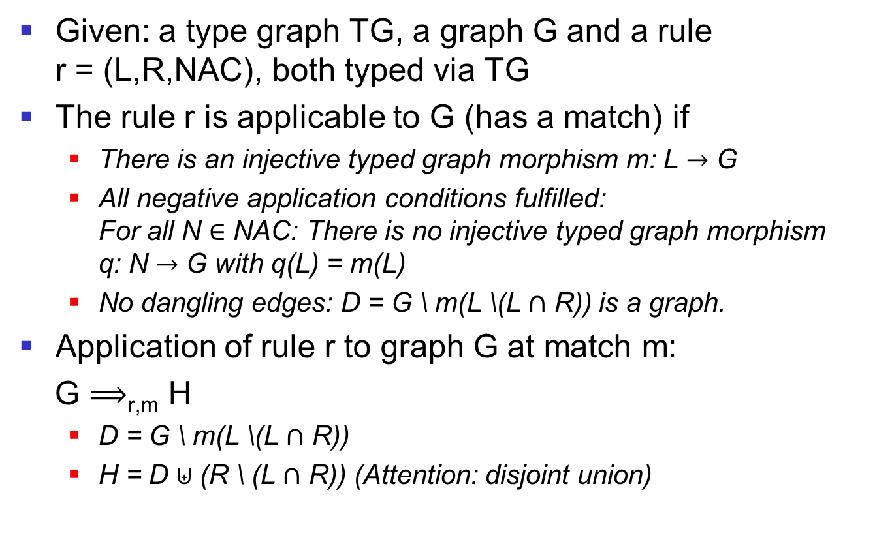
Application of a typed rule
Given: a type graph TG, a graph G and a rule r = (L,R,NAC), both typed via TG
The rule r is applicable to G (has a match) if
  There is an injective typed graph morphism m: L $→$ G
  All negative application conditions fulfilled: For all N $∈$ NAC: There is no injective typed graph morphism q: N $→$ G with q(L) = m(L)
  No dangling edges: D = G \ m(L \(L $∩$ R)) is a graph.
Application of rule r to graph G at match m:
G $⟹$_{r,m} H
  D = G \ m(L \(L $∩$ R))
  H = D $⊎$ (R \ (L $∩$ R)) (Attention: disjoint union)
Notes:
Example on the panel with explicit type graph

Slide 28
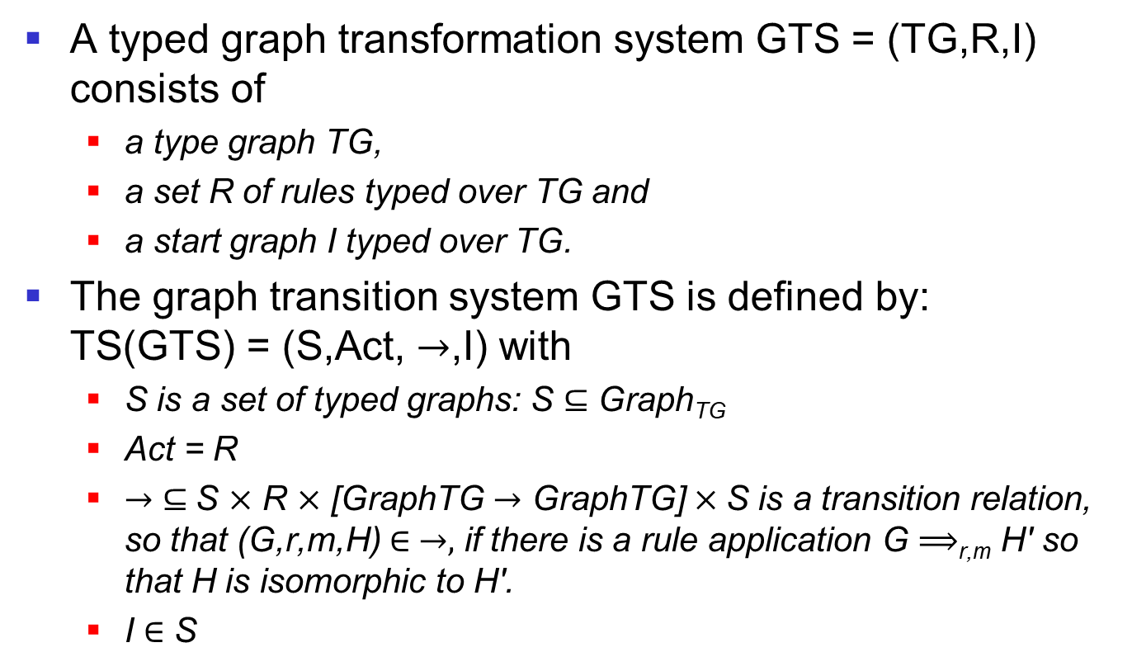
Typed graph transition system
A typed graph transformation system GTS = (TG,R,I) consists of
  a type graph TG,
  a set R of rules typed over TG and
  a start graph I typed over TG.
The graph transition system GTS is defined by: TS(GTS) = (S,Act, $→$,I) with
  S is a set of typed graphs: S $⊆$ Graph_{TG}
  Act = R
  $→$ $⊆$S $×$ R $×$ [GraphTG $→$ GraphTG] $×$S is a transition relation, so that (G,r,m,H) $∈ →,$ if there is a rule application G $⟹$_{r,m} H' so that H is isomorphic to H'.
  I $∈$ S
Notes:
Transition system for 3 cell buffers?

Slide 29
Attributed typed graph transformation
A type graph defines all object and data types involved (the class structure).
We distinguish between object nodes and data nodes.
  Data nodes represent data values.
  Edges from object nodes to data nodes are used to attribute objects.
Rules may use data variables and can specify calculations on attribute values.
Rules can have input and output parameters.
Notes:
How do we deal with data types? It is not appropriate to represent them in graph structures.
What would that mean? Unary number representation, string representation, calculation by graph change, etc.

Slide 30
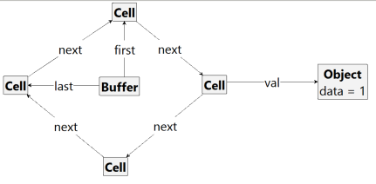
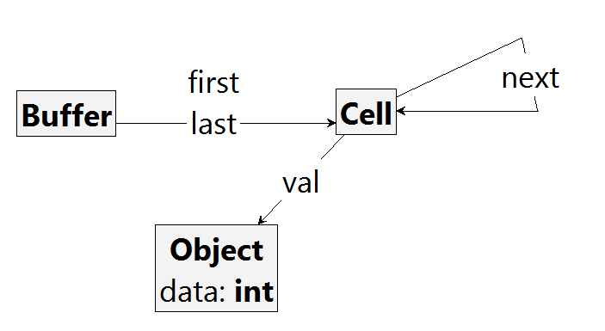
Example: Attributed Graphs
Attributed graph
Attributed type graph
Notes:
Similar to class and object diagrams
Modeling decision: What as a graph? What as a data type?
Example on the blackboard: Buffer with counter of occupied cells

Slide 31
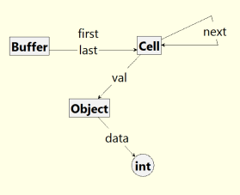
Example: Attributed Type Graph
Final view of the type graph
Representation in the Groove editor corresponds to the formal specification
Notes:
How to present it formally?
Data nodes vs. object nodes, attribution edges

Slide 32
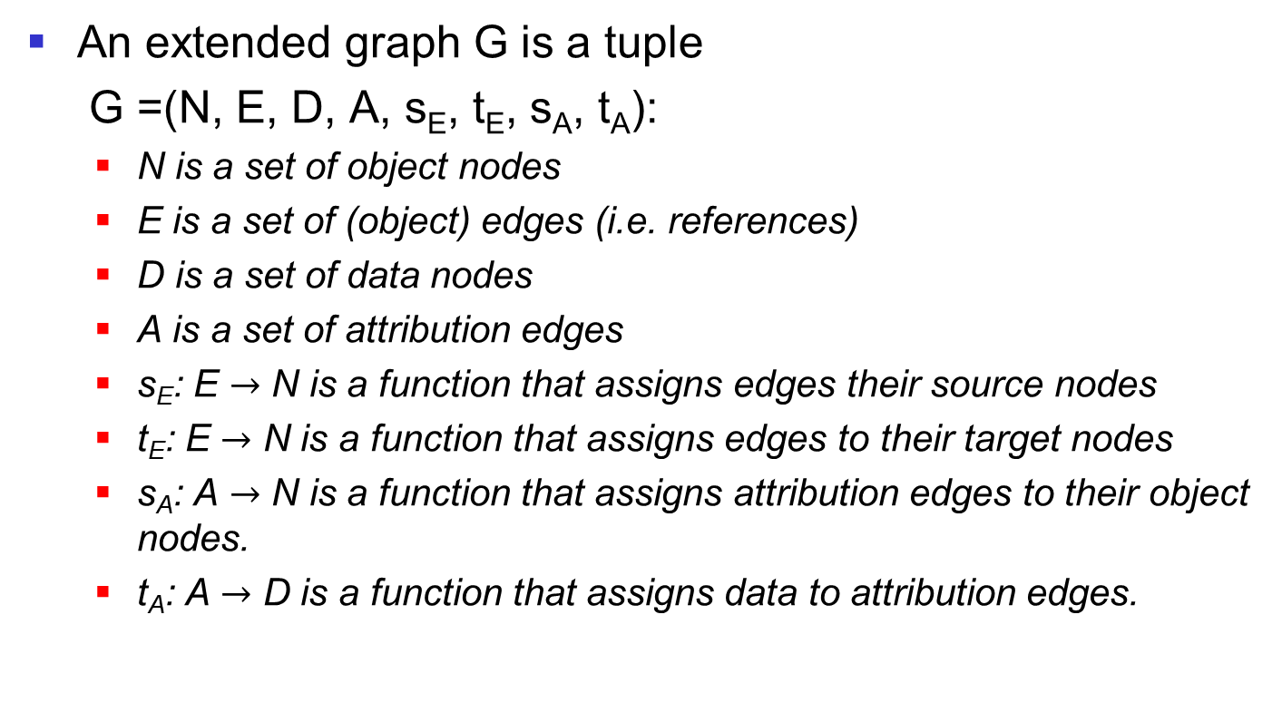
Definition: Extended Graph
An extended graph G is a tuple
G =(N, E, D, A, s_{E}, t_{E}, s_{A}, t_{A}):
  N is a set of object nodes
  E is a set of (object) edges (i.e. references)
  D is a set of data nodes
  A is a set of attribution edges
  s_{E}: E $→$ N is a function that assigns edges their source nodes
  t_{E}: E $→$ N is a function that assigns edges to their target nodes
  s_{A}: A $→$ N is a function that assigns attribution edges to their object nodes.
  t_{A}: A $→$ D is a function that assigns data to attribution edges.
Notes:
Formally represent circular graphs with data nodes

Slide 33
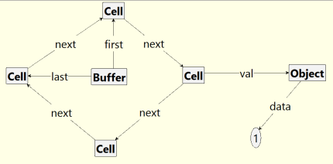
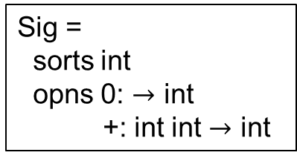
Example: Attributed Typed Graph
Sig =
sorts int
opns 0: $→$ int
+: int int $→$ int
Alg(Sig):
Dint is the set of all integers.
Representation in the Groove editor corresponds to the formal specification
Notes:
Data node int:1
Where are the other data nodes? What others are there? Infinite, but we only represent those we need.
In order to calculate later, we also need operations. Sig contains signatures, Alg the real operations.

Slide 34
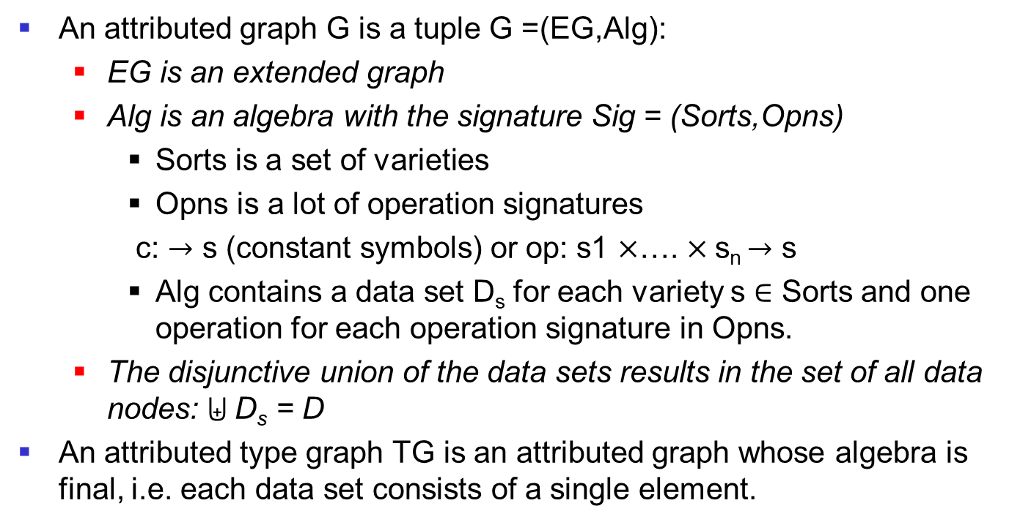

Definition: Attributed (Type) Graph
An attributed graph G is a tuple G =(EG,Alg):
  EG is an extended graph
  Alg is an algebra with the signature Sig = (Sorts,Opns)
    Sorts is a set of varieties
    Opns is a lot of operation signatures
    c: $→$ s (constant symbols) or op: s1 $×$…. $×$s_{n} $→$ s
    Alg contains a data set D_{s} for each variety s $∈$ Sorts and one operation for each operation signature in Opns.
  The disjunctive union of the data sets results in the set of all data nodes: D_{s} = D
An attributed type graph TG is an attributed graph whose algebra is final, i.e. each data set consists of a single element.
s $∈$ S
Notes:
Formally represent circular graphs
algebra of integers
Other algebras for signature int? Bool with false and "and", string with empty and concat, etc.
Here: Break

Slide 35
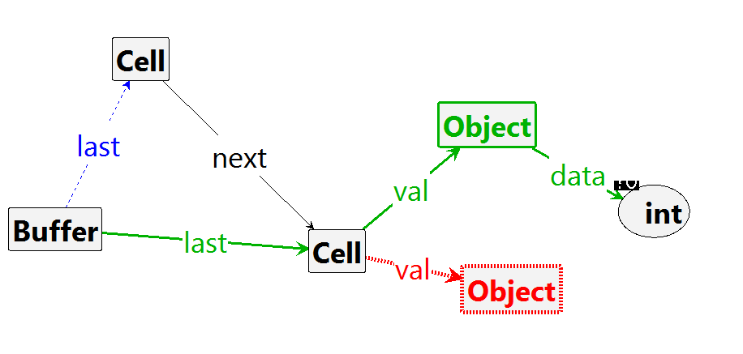
Example: Attributed Graph Rule
put(int)
Notes:
rule has an unnamed variable
Another example with term, e.g. adding x and y
How does this rule apply?
1. display LHS graph 2. assign variable
Example for rule match on the blackboard: Variable assignment, term mapping

Slide 36
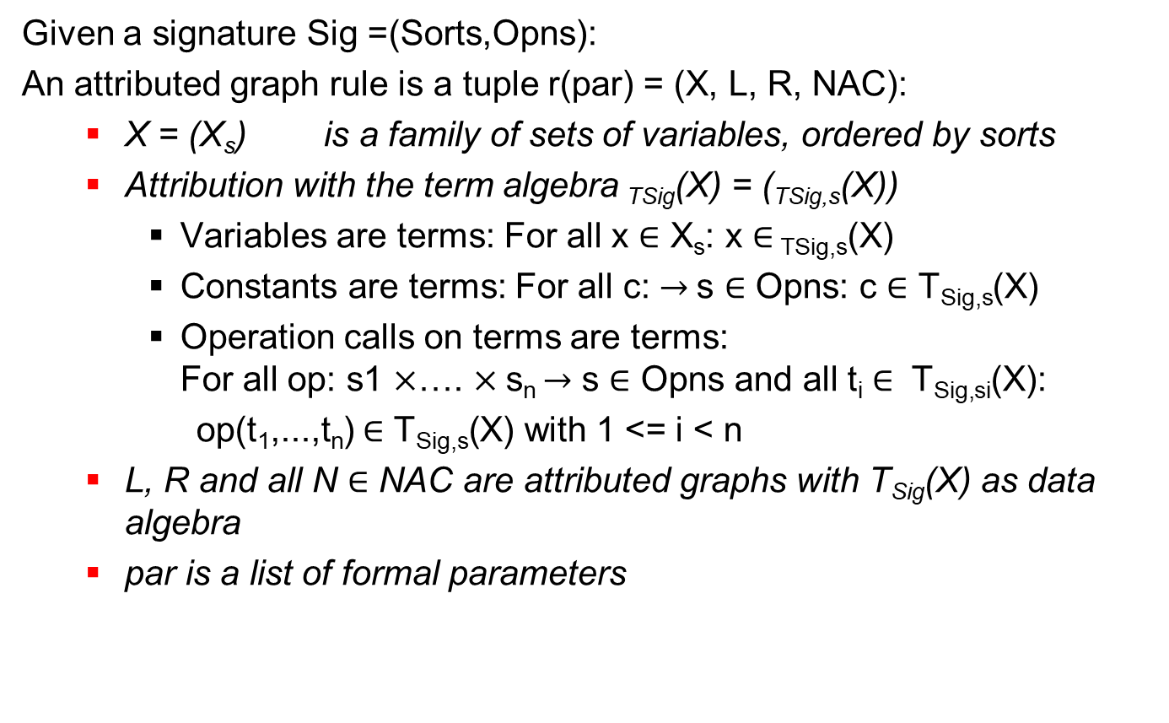


Attributed graph rule
Given a signature Sig =(Sorts,Opns):
An attributed graph rule is a tuple r(par) = (X, L, R, NAC):
  X = (X_{s}) is a family of sets of variables, ordered by sorts
  Attribution with the term algebra _{TSig}(X) = (_{TSig,s}(X))
    Variables are terms: For all x $∈$ X_{s}: x $∈$ _{TSig,s}(X)
    Constants are terms: For all c: $→$s $∈$ Opns: c $∈\text{T}\text{Sig}\text{,}\text{s}\text{(}\text{X}\text{)}$
    Operation calls on terms are terms: For all op: s1 $×$…. $×$s_{n} $→$ s $∈$ Opns and all t_{i} $∈ \text{T}\text{Sig}\text{,}\text{si}\text{(}\text{X}\text{)}$:
    op(t₁,...,t_{n}) $∈\text{T}\text{Sig}\text{,}\text{s}\text{(}\text{X}\text{)}$ with 1 <= i < n
  L, R and all N $∈$ NAC are attributed graphs with T_{Sig}(X) as data algebra
  par is a list of formal parameters
s $∈$ S
s $∈$ S
Notes:
Rules must make it possible to calculate. How?
List terms for the term algebra T_int(X) with X = {x,y}

Slide 37
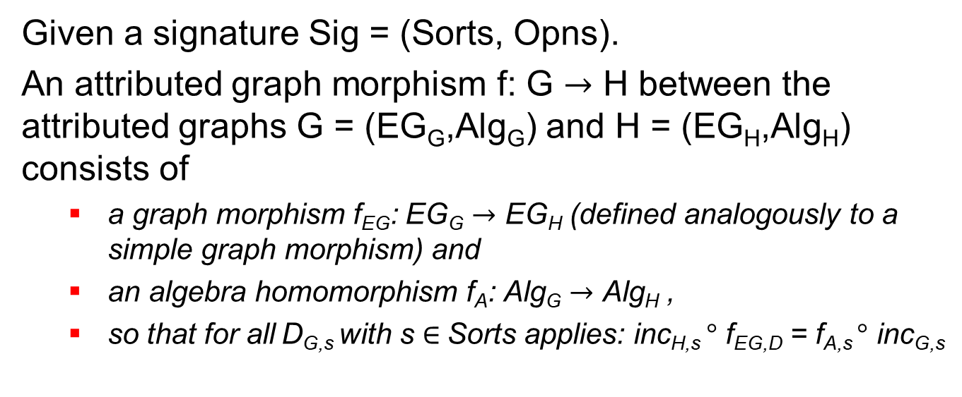
Attributed graph morphism
Given a signature Sig = (Sorts, Opns).
An attributed graph morphism f: G $→$ H between the attributed graphs G = (EG_{G},Alg_{G}) and H = (EG_{H},Alg_{H}) consists of
  a graph morphism f_{EG}: EG_{G} $→$ EG_{H} (defined analogously to a simple graph morphism) and
  an algebra homomorphism f_{A}: Alg_{G} $→$ Alg_{H} ,
  so that for all D_{G,s} with s $∈$Sorts applies: inc_{H,s} $°$ f_{EG,D} = f_{A,s} $°$ inc_{G,s}
f_{A,s}
D_{G,s}
D_{H,s}
inc_{G,s}
=
inc_{H,s}
f_{EG,D}
D_{G}
D_{H}
Notes:
Algebrahomomorphism f: A -> B:
f(c_A) = c_B
f(op_A(a1,...,an))= op_B(f(a1),...,f(an))

Slide 38
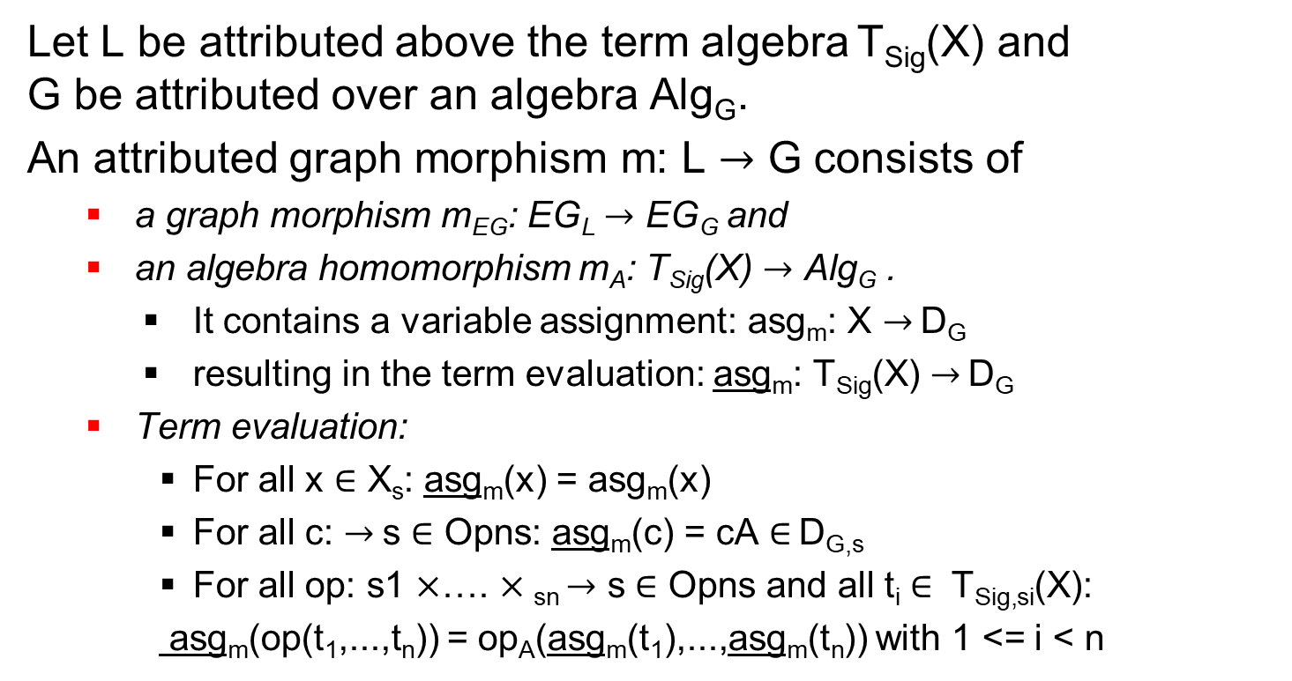
Variable assignment and term evaluation
Let L be attributed above the term algebra T_{Sig}(X) and G be attributed over an algebra Alg_{G}.
An attributed graph morphism m: L $→$ G consists of
  a graph morphism m_{EG}: EG_{L} $→$ EG_{G} and
  an algebra homomorphism m_{A}: T_{Sig}(X) $→$ Alg_{G} .
    It contains a variable assignment: asg_{m}: X $→$ D_{G}
    resulting in the term evaluation: asg_{m}: T_{Sig}(X) $→$ D_{G}
  Term evaluation:
    For all x $∈$ X_{s}: asg_{m}(x) = asg_{m}(x)
    For all c: $→$s $∈$ Opns: asg_{m}(c) = cA $∈$ D_{G,s}
    For all op: s1 $×$…. $×$_{sn} $→$ s $∈$ Opns and all t_{i} $∈ \text{T}\text{Sig}\text{,}\text{si}\text{(}\text{X}\text{)}$:
    asg_{m}(op(t₁,...,t_{n})) = op_{A}(asg_{m}(t₁),...,asg_{m}(t_{n})) with 1 <= i < n
Notes:
Given an attributed graph transformation (graph, rule, match) : write it down formally.

Slide 39
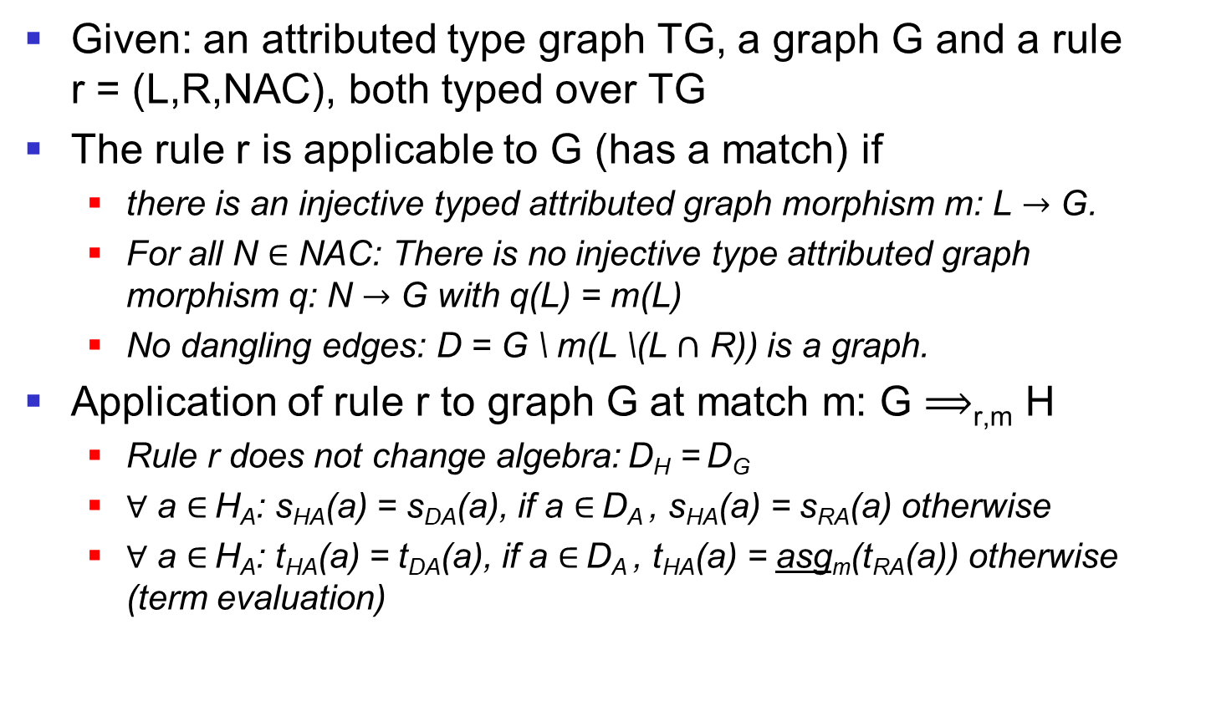
Applying an Attributed Rule
Given: an attributed type graph TG, a graph G and a rule r = (L,R,NAC), both typed over TG
The rule r is applicable to G (has a match) if
  there is an injective typed attributed graph morphism m: L $→$ G.
  For all N $∈$ NAC: There is no injective type attributed graph morphism q: N $→$ G with q(L) = m(L)
  No dangling edges: D = G \ m(L \(L $∩$ R)) is a graph.
Application of rule r to graph G at match m: G $⟹$_{r,m} H
  Rule r does not change algebra: D_{H} = D_{G}
  $∀$ a $∈$ H_{A}: s_{HA}(a) = s_{DA}(a), if a $∈$ D_{A} , s_{HA}(a) = s_{RA}(a) otherwise
  $∀$ a $∈$ H_{A}: t_{HA}(a) = t_{DA}(a), if a $∈$ D_{A} , t_{HA}(a) = asg_{m}(t_{RA}(a)) otherwise (term evaluation)
Notes:
Example in the table: Attributed rule with term evaluation (Add)

Slide 40
Overview
How can objects be specified in graphs?
  Objects as instances of classes
  Objects as encapsulation of attributes
  References between objects
How can methods be defined?
How do we deal with data types?
How can inheritance be formally defined?
  Abstract classes
  Single versus multiple inheritance
Notes:
How do we deal with polymorphism?

Slide 41
Type graphs with inheritance
Abstract object types
  have no instances and
  may be used in rules.
Inheritance relationships between object types
  Generalization of graph morphisms: Types do no longer have to be the same, but follow a refinement relationship.
Notes:
Abstract types allow rules to be summarized.
Compacting of a graph transformation system

Slide 42
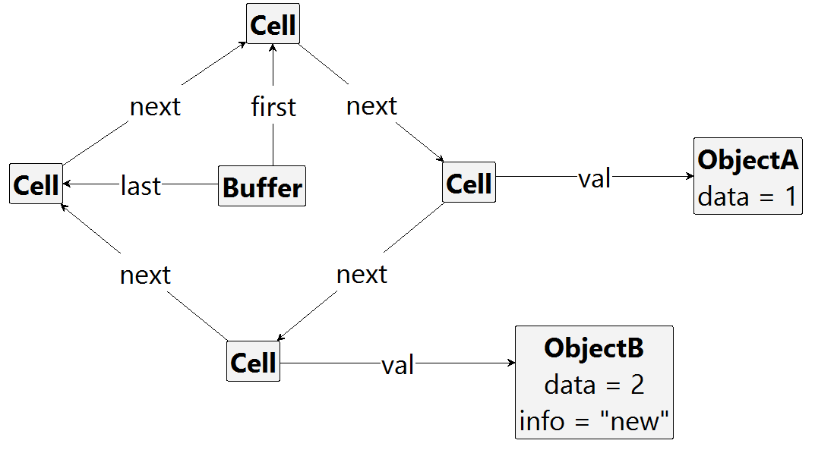
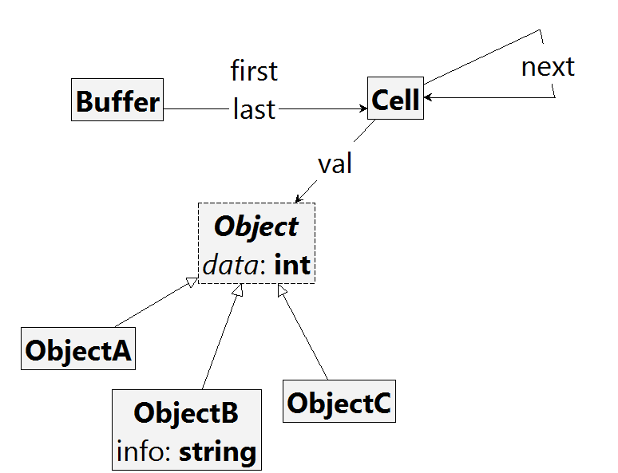
Example: Type graph with inheritance
Typed graph
Type graph with inheritance and
abstract type Object
Notes:
Inheritance as known: Subtypes may have their own attributes and edge types
Attributes and references of supertypes are inherited.
Flat beaten type graph

Slide 43
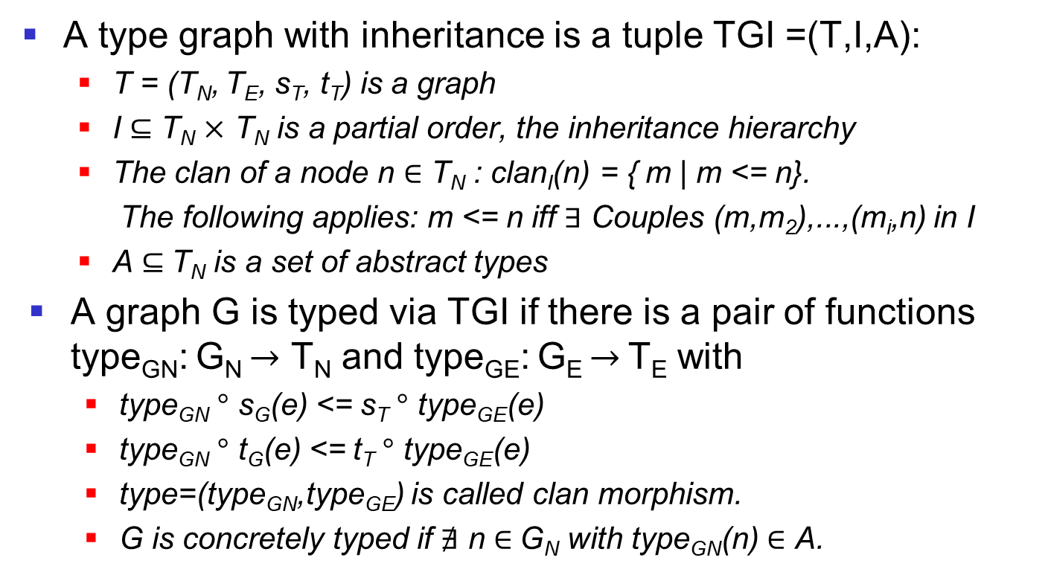
Definition: Type graph with inheritance and clan morphism
A type graph with inheritance is a tuple TGI =(T,I,A):
  T = (T_{N}, T_{E}, s_{T}, t_{T}) is a graph
  I $⊆$ T_{N} $×$ T_{N} is a partial order, the inheritance hierarchy
  The clan of a node n $∈$ T_{N} : clan_{I}(n) = { m | m <= n}.
  The following applies: m <= n iff $∃$ Couples (m,m₂),...,(m_{i},n) in I
  A $⊆$T_{N} is a set of abstract types
A graph G is typed via TGI if there is a pair of functions type_{GN}: G_{N} $→$ T_{N} and type_{GE}: G_{E} $→$ T_{E} with
  type_{GN} $°$ s_{G}(e) <= s_{T} $°$ type_{GE}(e)
  type_{GN} $°$ t_{G}(e) <= t_{T} $°$ type_{GE}(e)
  type=(type_{GN},type_{GE}) is called clan morphism.
  G is concretely typed if $∄$ n $∈$G_{N} with type_{GN}(n) $∈$ A.
Notes:
No need: $∀$a $∈$A: clanI(a) $≠$ {a} but if not fulfilled, then a is useless
Guys don't have to be the same.
Partial order: reflexivity, anti-symmetry, transitivity
What kind of inheritance is formalized here? Multiple inheritance

Slide 44
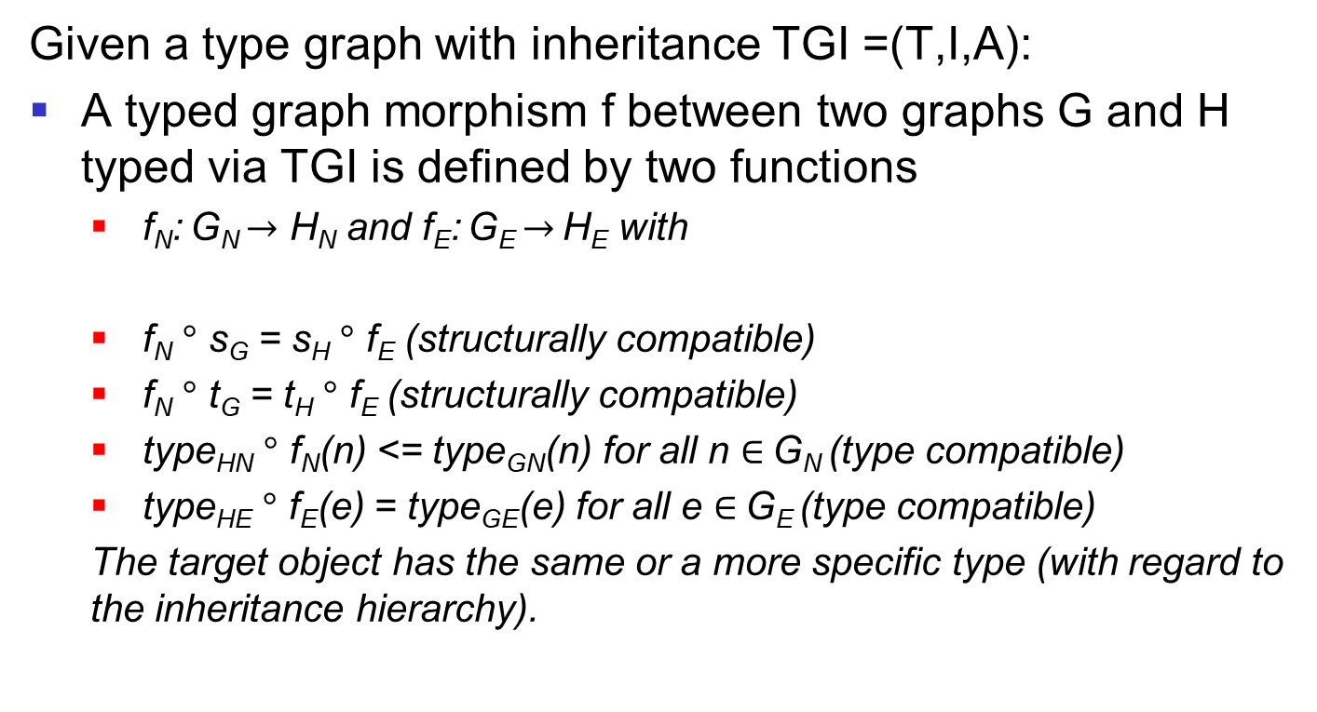
Definition: Typed Graph Morphism
Given a type graph with inheritance TGI =(T,I,A):
A typed graph morphism f between two graphs G and H typed via TGI is defined by two functions
  f_{N}: G_{N} $→$ H_{N} and f_{E}: G_{E} $→$ H_{E} with
  f_{N} $°$ s_{G} = s_{H} $°$ f_{E} (structurally compatible)
  f_{N} $°$ t_{G} = t_{H} $°$ f_{E} (structurally compatible)
  type_{HN} $°$ f_{N}(n) <= type_{GN}(n) for all n $∈$ G_{N} (type compatible)
  type_{HE} $°$ f_{E}(e) = type_{GE}(e) for all e $∈$ G_{E} (type compatible)
  The target object has the same or a more specific type (with regard to the inheritance hierarchy).
Notes:
Edge inheritance would also be possible (supported in Groove)

Slide 45
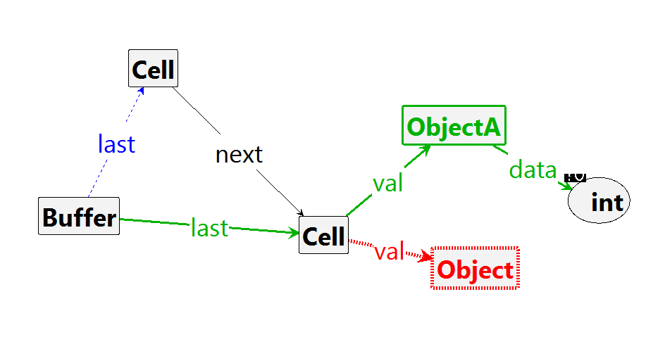
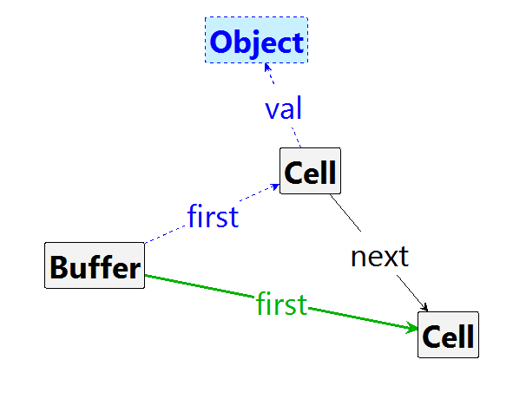
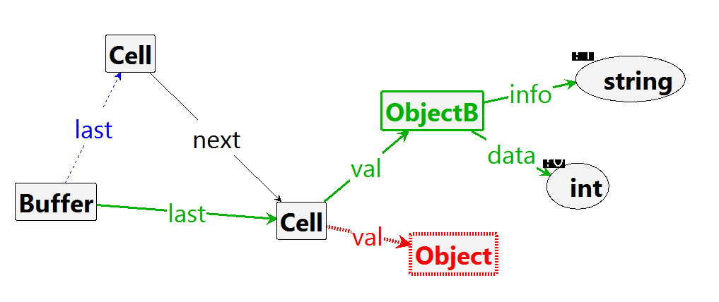
Example: Abstract Graph Rules
putObjectA
get
putObjectB
Notes:
What are the concrete rules to get?
Why is there no more abstract put?
Rule get, but only if not ObjectA?

Slide 46
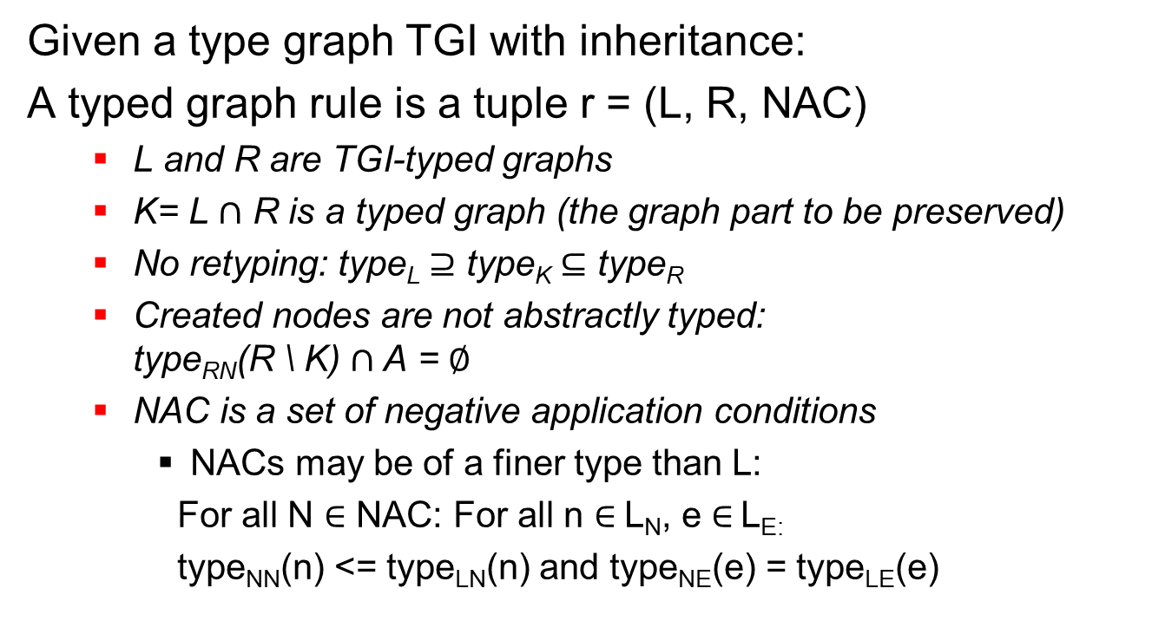
Typed graph rule
Given a type graph TGI with inheritance:
A typed graph rule is a tuple r = (L, R, NAC)
  L and R are TGI-typed graphs
  K= L $∩$ R is a typed graph (the graph part to be preserved)
  No retyping: type_{L} $⊇$ type_{K} $⊆$ type_{R}
  Created nodes are not abstractly typed: type_{RN}(R \ K) $∩$A = $∅$
  NAC is a set of negative application conditions
    NACs may be of a finer type than L:
    For all N $∈$ NAC: For all n $∈$L_{N}, e $∈$ L_{E:}
    type_{NN}(n) <= type_{LN}(n) and type_{NE}(e) = type_{LE}(e)

Slide 47
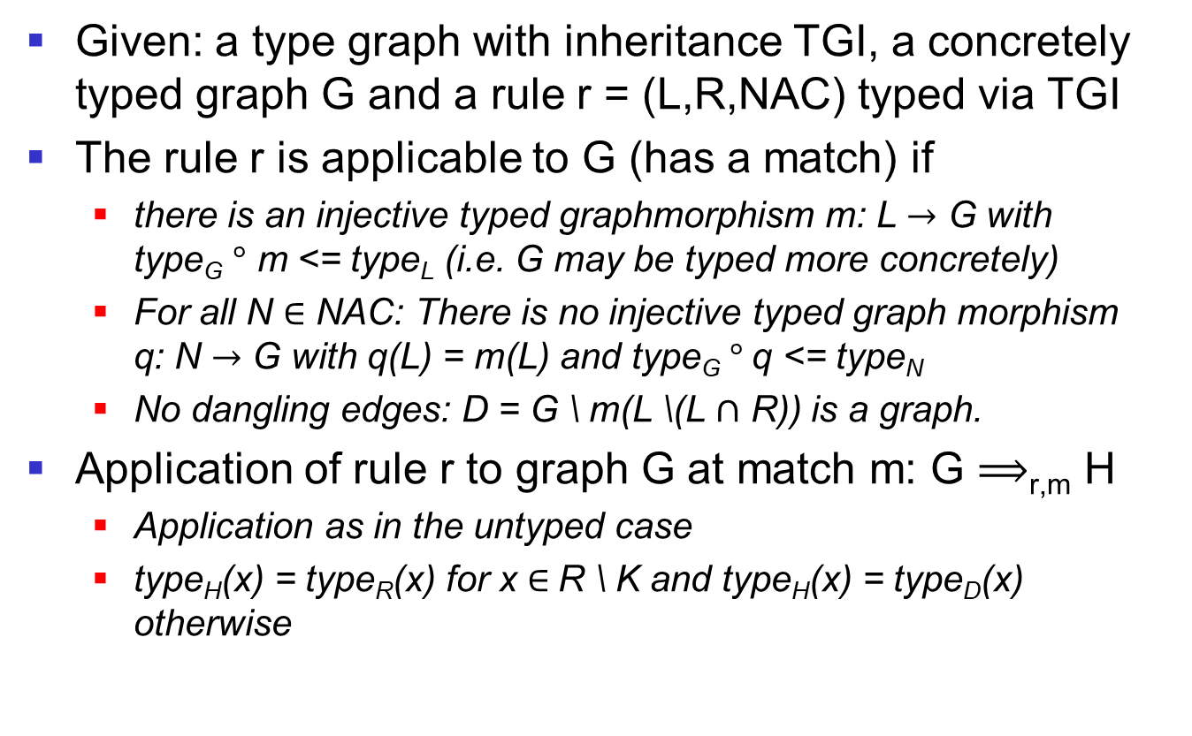
Application of a rule
Given: a type graph with inheritance TGI, a concretely typed graph G and a rule r = (L,R,NAC) typed via TGI
The rule r is applicable to G (has a match) if
  there is an injective typed graphmorphism m: L $→$ G with type_{G} $°$ m <= type_{L} (i.e. G may be typed more concretely)
  For all N $∈$ NAC: There is no injective typed graph morphism q: N $→$ G with q(L) = m(L) and type_{G} $°$q <= type_{N}
  No dangling edges: D = G \ m(L \(L $∩$ R)) is a graph.
Application of rule r to graph G at match m: G $⟹$_{r,m} H
  Application as in the untyped case
  type_{H}(x) = type_{R}(x) for x $∈$R \ K and type_{H}(x) = type_{D}(x) otherwise

Slide 48
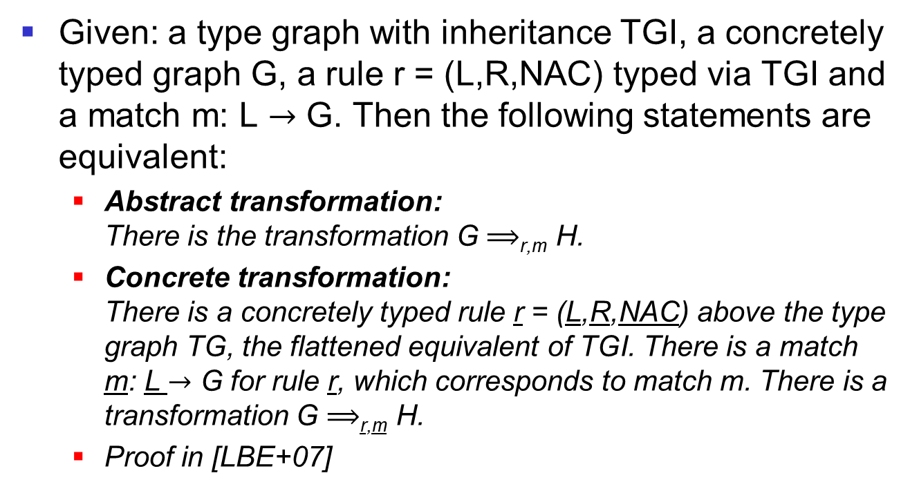
Theorem: Equivalence result
Given: a type graph with inheritance TGI, a concretely typed graph G, a rule r = (L,R,NAC) typed via TGI and a match m: L $→$ G. Then the following statements are equivalent:
  Abstract transformation: There is the transformation G $⟹$_{r,m} H.
  Concrete transformation: There is a concretely typed rule r = (L,R,NAC) above the type graph TG, the flattened equivalent of TGI. There is a match m: L $→$ G for rule r, which corresponds to match m. There is a transformation G $⟹$_{r,m} H.
  Proof in [LBE+07]

Slide 49
Summary
For the specification of object-oriented systems, we use attributed typed graph transformation.
  Node types correspond to classes and data types.
  Edge types correspond to object references.
  Object structures are specified by graphs.
  Data types are specified by algebras.
  Inheritance of classes and abstract classes are considered.
  Polymorphism is not considered.

Slide 50
Literature
Eduardo Zambon, Arend Rensink: Using Graph Transformations and Graph Abstractions for Software Verification. ECEASST 38 (2011)
Niaz Arijo, Reiko Heckel: View-based Modelling and State-Space Generation for Graph Transformation Systems, ECEASST 47 (2012)
Juan de Lara, Roswitha Bardohl, Hartmut Ehrig, Karsten Ehrig, Ulrike Prange, Gabriele Taentzer: Attributed graph transformation with node type inheritance, Theoretical Computer Science 376 (2007)

Slide 51
Model Checking of Object-Oriented Systems
Gabriele Taentzer

Slide 52
Overview
How do we specify security and liveliness properties for object-oriented systems?
  Through temporal logical formulas about the existence of object-oriented structures
What does model checking of object-oriented systems look like?
  Model Checking of graph transition systems
How can we deal with the state space explosion?
  Simple graph programs
  Conditions of application for rules
  Abstract graphs
Notes:
How can we deal with the state space explosion?
Simple graph programs
Conditions of application for rules
Abstract Graphs

Slide 53
Example: Circular buffer
Type graph
Start graph
Rule set:

Slide 54
Example: Circular buffer
Rule set:
Desired properties:
  The last cell is not followed by a filled cell except the first.
  The empty buffer must always be accessible.
Notes:
Which property is safety property or liveliness property?

Slide 55
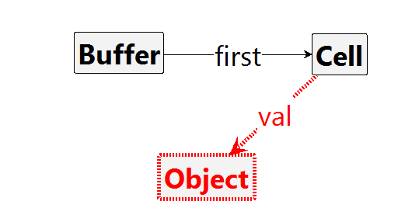
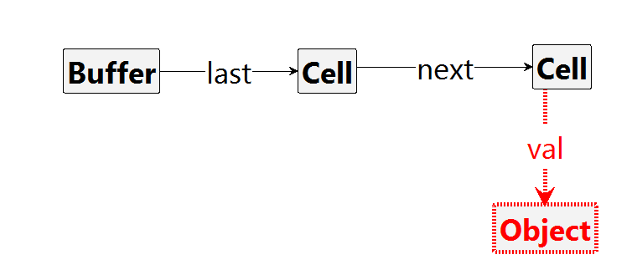
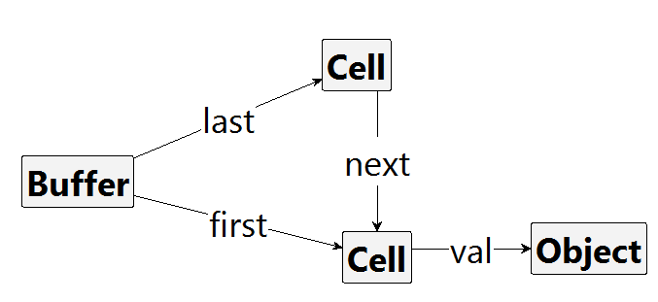
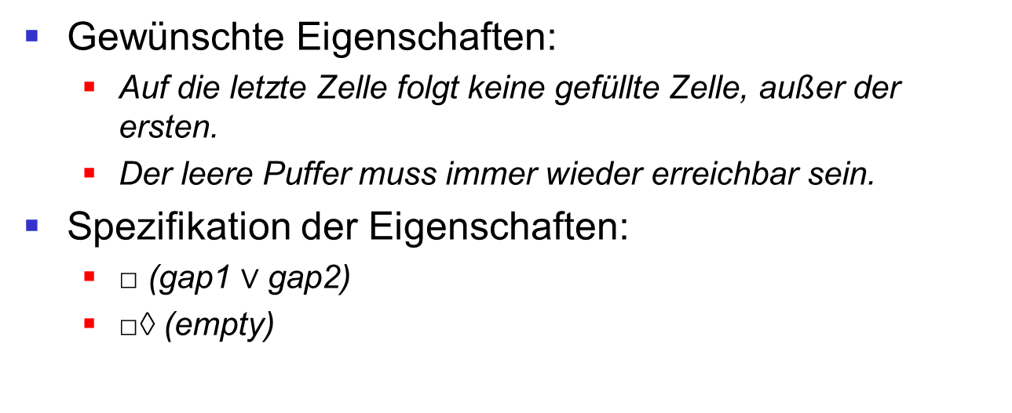
Example: Circular buffer
Desired properties:
  The last cell is not followed by a filled cell except the first.
  The empty buffer must always be accessible.
Specification of properties:
  □ (gap1 $∨$ gap2)
  □◊ (empty)
empty
gap1
gap2
[KR06]
Notes:
What structures?
Further features:
Each cell contains at most one object.
Each cell must be followed by one.
The buffer can become full from time to time.
If extend can be applied, then finally put or get can be applied.

Slide 56
Graph formulas
Graph conditions specify the existence of graph structures.
  A graph condition is specified using an identical rule.
  A graph condition requires the existence of a structure in such a way that it cannot be extended to forbidden structures.
Graph formulas specify temporal logical statements about graph conditions.

Slide 57
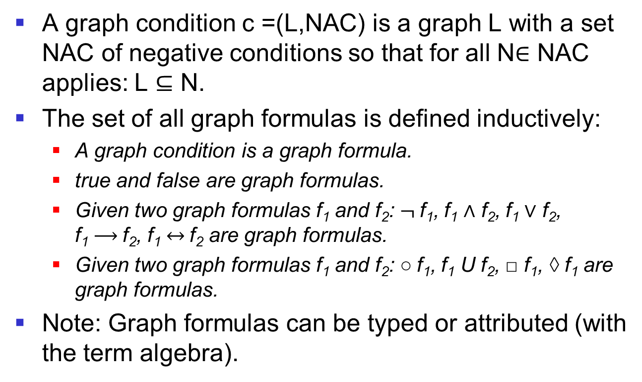
Definition: Graph formula
A graph condition c =(L,NAC) is a graph L with a set NAC of negative conditions so that for all N$∈$ NAC applies: L $⊆$ N.
The set of all graph formulas is defined inductively:
  A graph condition is a graph formula.
  true and false are graph formulas.
  Given two graph formulas f₁ and f₂: $¬$f₁, f₁ $∧$ f₂, f₁ $∨$ f₂, f₁ $⟶$f₂, f₁ $↔$f₂ are graph formulas.
  Given two graph formulas f₁ and f₂: $\text{○}$f₁, f₁ U f₂, □ f₁, ◊ f₁ are graph formulas.
Note: Graph formulas can be typed or attributed (with the term algebra).

Slide 58
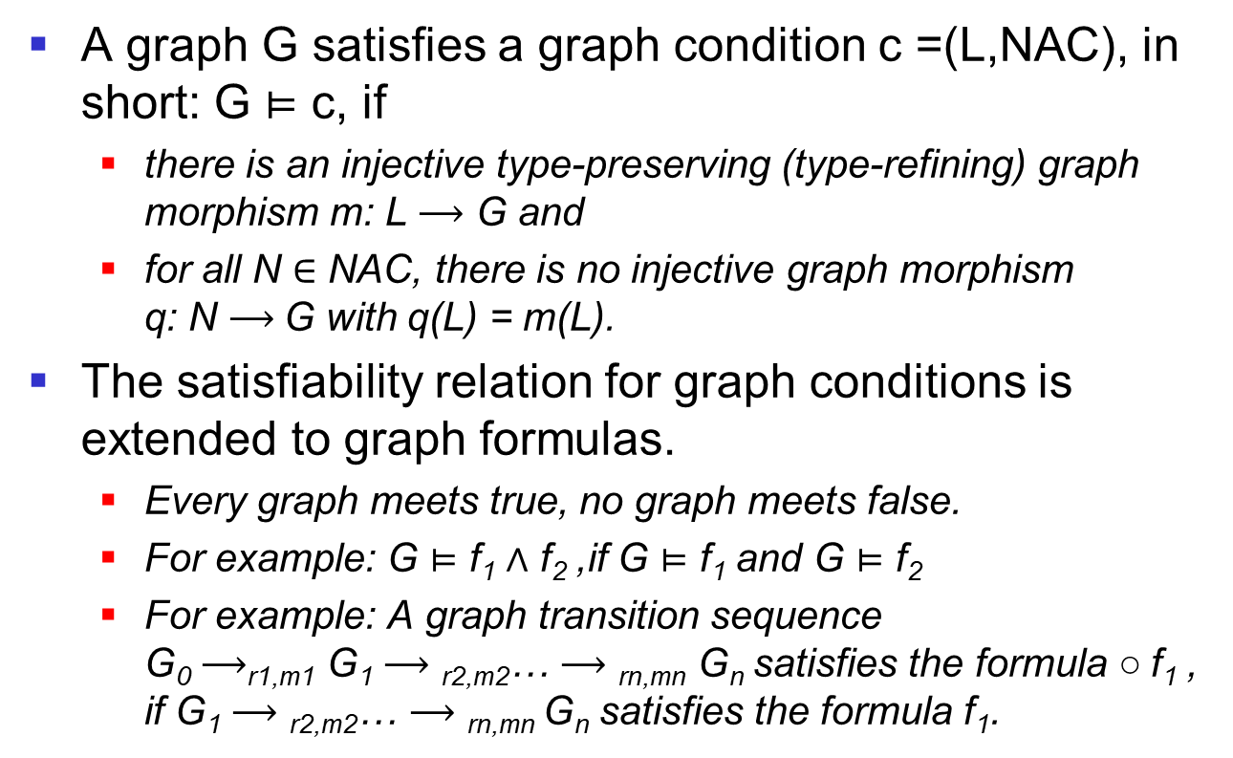
Definition: Semantics of a graph formula
A graph G satisfies a graph condition c =(L,NAC), in short: G $⊨$ c, if
  there is an injective type-preserving (type-refining) graph morphism m: L $⟶$ G and
  for all N $∈$ NAC, there is no injective graph morphism q: N $⟶$G with q(L) = m(L).
The satisfiability relation for graph conditions is extended to graph formulas.
  Every graph meets true, no graph meets false.
  For example: G $⊨$ f₁ $∧$ f₂ ,if G $⊨$ f₁ and G $⊨$ f₂
  For example: A graph transition sequence G₀ $⟶$_{r1,m1} G₁ $⟶\text{r}\text{2,}\text{m}\text{2}$… $⟶\text{rn}\text{,}\text{mn}$ G_{n} satisfies the formula $\text{○}$f₁ , if G₁ $⟶\text{r}\text{2,}\text{m}\text{2}$… $⟶\text{rn}\text{,}\text{mn}$G_{n} satisfies the formula f₁.

Slide 59
Intuitive Semantics of graph formulas
[BK08]

Slide 60
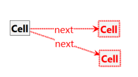
Multiplicities and graph conditions
1
1
1
1
*
1
Type graph with multiplicities
Graph condition:
"A cell has at most one subsequent cell".
Notes:
What other graph conditions?

Slide 61
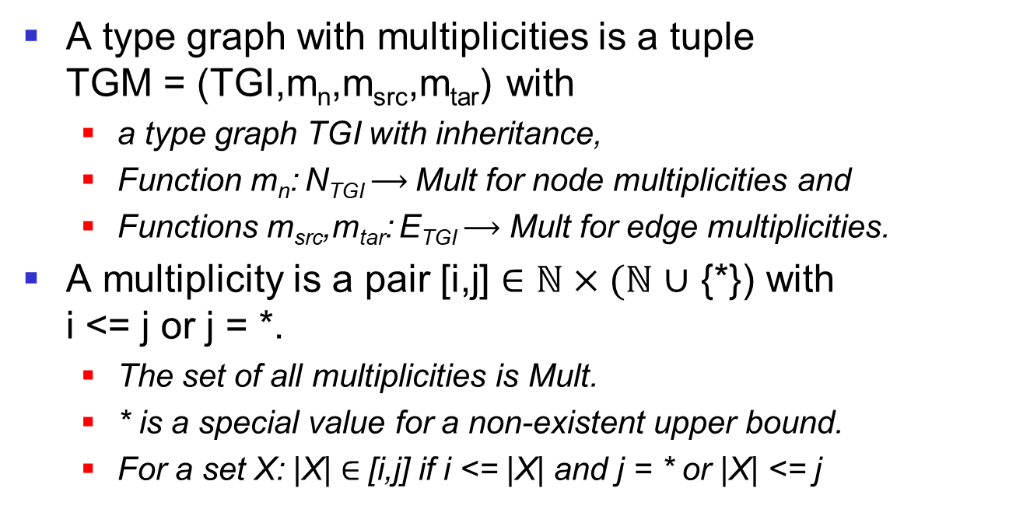
Definition: Type graph with multiplicities
A type graph with multiplicities is a tuple TGM = (TGI,m_{n},m_{src},m_{tar}) with
  a type graph TGI with inheritance,
  Function m_{n}: N_{TGI} $⟶$Mult for node multiplicities and
  Functions m_{src},m_{tar}: E_{TGI} $⟶$ Mult for edge multiplicities.
A multiplicity is a pair [i,j] $∈ℕ×(ℕ$ $∪$ {*}) with i <= j or j = *.
  The set of all multiplicities is Mult.
  * is a special value for a non-existent upper bound.
  For a set X: |X| $∈$[i,j] if i <= |X| and j = * or |X| <= j
Notes:
What is the relationship between node multiplicity and inheritance? Do they have to be compatible or is there simply no other instance? (For example, I can require that a subtype has at least 2, but allow a maximum of 1 from the supertype).
If they are not compatible, there is no instance.

Slide 62
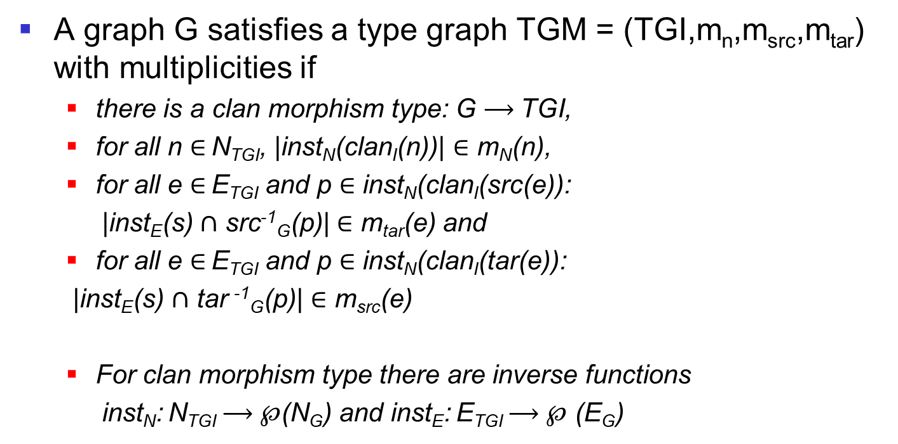
Definition: Semantics of a type graph with multiplicities
A graph G satisfies a type graph TGM = (TGI,m_{n},m_{src},m_{tar}) with multiplicities if
  there is a clan morphism type: G $⟶$TGI,
  for all n $∈$ N_{TGI}, |inst_{N}(clan_{I}(n))| $∈$ m_{N}(n),
  for all e $∈$ E_{TGI} and p $∈$ inst_{N}(clan_{I}(src(e)):
  |inst_{E}(s) $∩$ src⁻¹_{G}(p)| $∈$ m_{tar}(e) and
  for all e $∈$ E_{TGI} and p $∈$ inst_{N}(clan_{I}(tar(e)):
  |inst_{E}(s) $∩$ tar ⁻¹_{G}(p)| $∈$ m_{src}(e)
  For clan morphism type there are inverse functions
  inst_{N}: N_{TGI} $⟶$ $℘$(N_{G}) and inst_{E}: E_{TGI} $⟶$ $℘$ (E_{G})

Slide 63
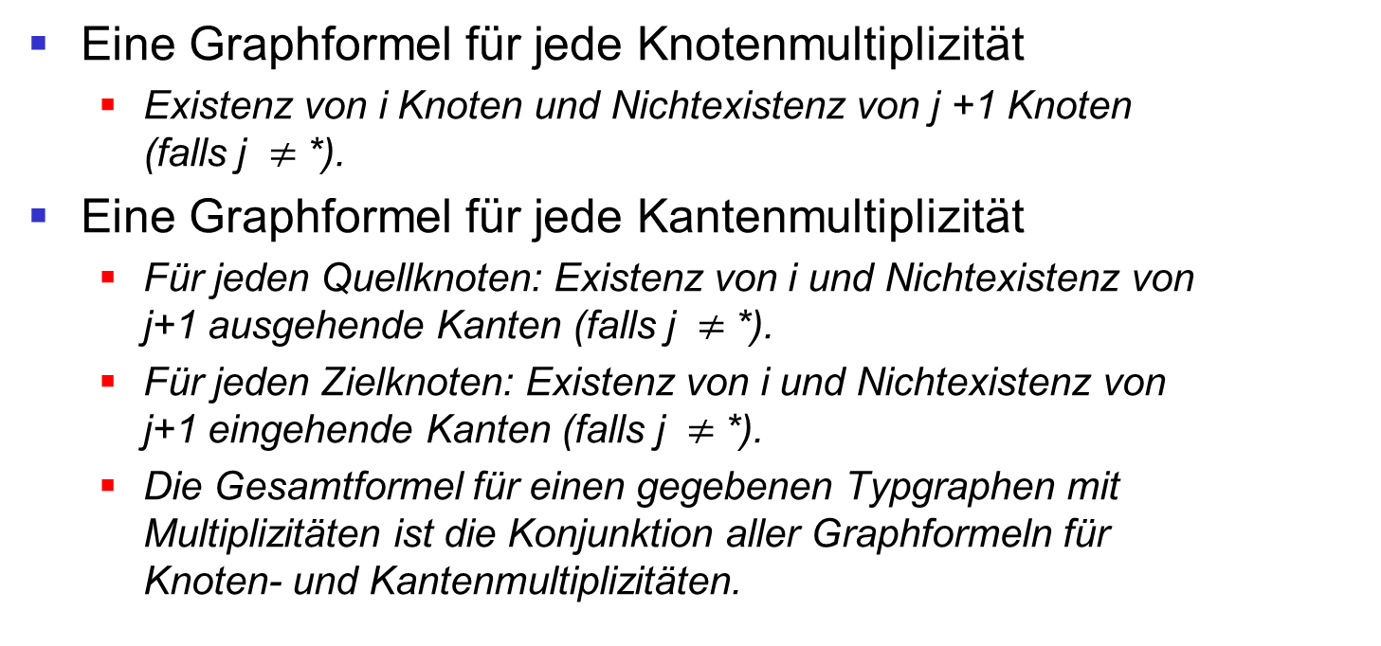
Graph formulas for multiplicities
A graph formula for each node multiplicity
  Existence of i nodes and non-existence of j +1 nodes (if j $≠$*).
A graph formula for each edge multiplicity
  For each source node: existence of i and non-existence of j+1 outgoing edges (if j $≠$*).
  For each target node: existence of i and non-existence of j+1 incoming edges (if j $≠$*).
  The overall formula for a given type graph with multiplicities is the conjunction of all graph formulas for node and edge multiplicities.
Notes:
For the example type graph on slide 163 show
What do the graph formulas look like?
Invariants: Always Graph Condition
For edge multiplicities we need nested graph conditions.

Slide 64

Example: Circular buffer
Rule set:
Specification of properties:
  □ (gap1 $∨$ gap2)
  □◊ (empty)
empty
Are these properties fulfilled?
gap1
gap2
Notes:
Desired properties:
The buffer has no gap, i.e. a filled cell that is not the last one is not followed by an empty cell.
The empty buffer must always be accessible
No, because extend may insert a new cell at any point. Better: After last cell

Slide 65
Overview
How do we specify security and liveliness properties for object-oriented systems?
  Through temporal logical formulas about the existence of object-oriented structures
What does model checking of object-oriented systems look like?
  Model Checking of graph transition systems
How can we deal with the state space explosion?
  Simple graph programs
  Conditions of application for rules
  Abstract Graphs

Slide 66

Example: Circular buffer
For a given start graph, the set of all rule applications leads to a finite transition system.

Slide 67

Example: Circular buffer
Adding the rule extend leads to an infinite state space.
Graph programs can limit the possible rule applications.
  Example graph programs that result in finite transition systems:
(get | put)*;
extend |
(get | put)*;

Slide 68

Example: Circular buffer
The addition of further application conditions can further restrict control applications.
Recurring structures are combined. The results are abstract graphs:
  The example abstract graph differentiates only between exactly one element or several.
Notes:
Shape for empty buffer with n cells

Slide 69
Over-approximation
Through abstraction, many states are combined.
This can result in an over-approximation:
  If a property is not valid in the abstract system, it can still be valid in the concrete system. However, this is not taken into account.
  So errors may be reported that are not errors. These results are called false positives.

Slide 70

Over- versus under-approximation
If an analysis of a system S is not executable or takes too long, an over- and/or under-approximation is typically performed.
Overapproximation: The analysis is performed on a system S' with Sem(S) $⊆$Sem(S').
Underapproximation: The analysis is performed on a system S' with Sem(S') $⊆$Sem(S).
Effects:
  Overapproximation leads to false positive results.
  Underapproximation leads to false negative results.
Notes:
Sem is the flat transition system.

Slide 71

Example: Over- versus underapproximation
Analysis: Detection of a property P on a transition system S
Over-approximation:
  S is abstracted to S' with Sem(S) $⊆$Sem(S'). S‘ allows more executions.
  If a property P does not hold in S', it could still hold in S.
Under-approximation:
  S' contains some test cases of S. Therefore Sem(S') $⊆$Sem(S).
  If a property P holds in S', it maynot hold in S.

Slide 72
Summary
Graph formulas specify temporal properties of object-oriented systems.
Graph formulas can be verified on graph transition systems by means of model checking.
  This is only possible on finite (small) state spaces.
  A state space explosion can be triggered by many possible data values or recurring object structures.
  The state space can be reduced by graph programs, application conditions for rules and abstract graphs.

Slide 73
Literature
Gabriele Taentzer, Arend Rensink: Ensuring Structural Constraints in Graph-Based Models with Type Inheritance. FASE 2005: 64-79
Eduardo Zambon, Arend Rensink: Using Graph Transformations and Graph Abstractions for Software Verification. ECEASST 38 (2011)
Amir Hossein Ghamarian, Maarten de Mol, Arend Rensink, Eduardo Zambon, Maria Zimakova: Modelling and Analysis Using GROOVE, STTT 14(1): 15-40 (2012)

Slide 74
Parallel and sequential independence of graph transformations
Gabriele Taentzer

Slide 75
Overview
Graph transition systems:
  Formal description of system behaviour
  Parallel control applications
Which properties are interesting for graph transition systems?
  Temporal logical statements
How can we prove this?
  In general not at all -> Halting problem
  State-based: Model checking
  State independently: Sufficient properties for rules

Slide 76
Overview
Parallel and sequential independence of rule applications without NACs
Properties:
  Independent rule applications can take place in any order. (Local Church Rosser)
  Independent rule applications can also take place in parallel. (parallelism theorem)
Parallel and sequential independence of rule applications with NACs

Slide 77
Example: Circular buffer
Examples of parallel actions:
Two processes want to write to a circular buffer simultaneously.
One process wants to write in, another wants to read out.
A process wants to write and at the same time the buffer should be extended by one cell.

Slide 78
Example: Conflict-free transitions
Applications of rule put are parallel independent of applications of rule get.
  If both rules are applicable, they can be applied simultaneously or in any order.
Notes:
Example on the blackboard, with overlap graphs

Slide 79
Example: Transitions with conflicts
An application of the rule get can conflict with an application of the rule extend.
  If both rules are applicable, they cannot always be applied simultaneously or in any order.
Notes:
Second example

Slide 80
Parallel transitions
Parallelism through interleaving:
  Two transitions are executed in different orders.
True parallelism:
  Two transitions are combined into one step.
G
r1.m1
r2._{m2}
H1
H2
r2.m'₂
r1,m'₁
X

Slide 81

Verification procedure
How can we prove that two rule applications are always parallel independent?
Model checking:
  If rule r₁ is applicable, then r₂ is applicable in the next step, and vice versa:
  □ ((L₁ $⇒\text{○}$ L₂) $∧$(L₂ $⇒\text{○}$L₁))
  Does this formula express parallel independence?
Sufficient criteria:
  Rule r₁ only deletes what rule r₂ does not need and vice versa.
  Rule r₁ only creates what rule r₂ does not forbid and vice versa.
Notes:
Advantages and disadvantages of these detection methods?

Slide 82
Example: Parallel independent rule applications
Two applications of the rule extend are parallel independent of each other.
  Prerequisite: There are two different matches.
  If the rule is applicableat both matches, the applications can be performed simultaneously or in any order.
Notes:
Example on the blackboard

Slide 83

Definition: Parallel independent rule applications
Given: two rules r₁ = (L₁ $⊇$ K₁ $⊆$ R₁) and r₂ = (L₂ $⊇$ K₂ $⊆$ R₂)
Two transformation steps t₁: G $⇒$_{r1,m1} H₁ and t₂: G $⇒$_{r2,m2} H₂ are parallel independent, if
  their matches m₁ and m₂ overlap only in those graph elements of r1 and r2 that are to be preserved.
  Formally: m₁(L₁) $∩$ m₂(L₂) $⊆$ m₁(K₁) $∩$ m₂(K₂)
  Note: This definition does not cover negative application conditions.
Notes:
Discuss examples

Slide 84

Characterization: Parallel independent control applications
Two transformation steps t₁: G $⇒$_{r1,m1} H₁ and t₂: G $⇒$_{r2,m2} H₂ are parallel independent iff
  there are matches m1': L1 $→$ H2 and m2': L2 $→$ H1 such that m1'(x) = m1(x) for all x in L1 and m2'(y) = m2(y) for all y in L2.
⊇
⊆
⊇
⊆
R1
K1
L1
L2
K2
R2
m2‘
m1‘
m1
m2
⊇
⊆
⊇
⊆
H1
D1
G
D2
H2
Notes:
Reason: r1 and r2 overlap only in graphelements that are to be preserved. Therefore there are approaches L2 >H1 and L1 > H2
Proof:
"->": The following applies: m1(L1) $∩$ m2(L2) $⊆$ m1(K1) $∩$m2(K2)
Be y in L1:
1. m1(y) not in m2(L2): Da m2 and g2 together surjective => m1(y) in g2(D2)
2. m1(y) in m2(L2): => y in m1(K1) $∩$m2(K2) => y in m2(K2) => m1(y) in g2(D2)
It follows: There are x2: L1 -> D2 with x2(y) = g2(m1(y))
"<-": There are x1: L2 $→$ D1 and x2: L1 $→$ D2 with g1 $°$ x1 = m2 and g2 $°$ x2 = m1
Be y in m1(L1) $∩$ m2(L2) = m1(L1) $∩$ g1(x1(L2))
Because of TOE the following applies: There is z in K1 with m1(z) = y =g1(m1(z)) => y in m1(K1)
Analog: y in m2(K2)

Slide 85

Example: Parallel independence
We consider all pairs (r,s) of get and extend:
  (get,get), (get,extend), (extend,get)
Given a rule pair (r,s), there is a pair of rule applications G $⇒$_{r} H1 and G $⇒$_{s} H2,
  which is parallel independent?
  that is parallel dependent?
Notes:
(get,get): dependent
(get,extend): independent
(extend, get): dependent, if on the same next edge
(extend,extend): dependent, if on the same next edge

Slide 86
Example: Sequential independence
An application of rule get is sequentially dependent on an application of rule extend.
  An application of get never affects an application of extend, but an application of extend can affect an application of get.
  Applications of get and extend, whose matches do not overlap, are sequentially independent.

Slide 87

Definition: Sequentially independent rule applications
Given two rules r1 = (L1 $⊇$ K1 $⊆$ R1) and r2 = (L2 $⊇$ K2 $⊆$ R2)
Transformation step t1: G $⇒$_{r1,m1} H is sequentially indpendent from step t2: H $⇒$_{r2,m2} X if
  match m2 uses only graph elements of t1 to be preserved, i.e. t2 does not need anything that is created by t1,
  t2 does not delete anything that t1 uses or creates.
  Formally:
    Let n1: R1 → H be the co-match of t1 with n1(x) = m1(x) for x in K1
    n1(R1) $∩$ m2(L2) $⊆$ n1(K1) $∩$ m2(K2)

Slide 88

Characterization: Sequentially independent rule applications
Two transformation steps t1: G $⇒$_{r1,m1} H and t2: H $⇒$_{r2,m2} X are sequentially independent iff there is
  a match m2': L2 $→$ G with m2'(x) = m2(x) for all x in L2 and
  a co-match n1': R1 $→$ X with n1'(x) = n1(x) for all x in R1.
⊇
⊆
⊇
⊆
L1
K1
R1
L2
K2
R2
m2'
n1'
n1
m2
⊇
⊆
⊇
⊆
G
D1
H
D2
X
Notes:
Justification: If r1 produces nothing that needs r2, then r2 can already be applied to G.
Proof:
"->": 1. m1(y) not in m2(L2): Since m2 and g2 together are surjective.
2. m1(y) in m2(L2): m1(y) in m2(K2) and in g2(m2(K2))
It follows: m1(y) in g2(D2)
"<-": Opposite x1 and x2: From y in m1(L1) cap m2(L2) follows: y in m1(L1) cap g1(x1(L1))
Then there is z in K1 with y = m1(z) = g1(x1(z))
It follows: y in m1(K1) and similar y in m2(K2)

Slide 89

Example: Sequential independence
We consider all pairs (r,s) of rules get and extend:
  (get,get), (get,extend), (extend,get)
Given a rule pair (r,s), is there a sequence of rule applications G $⇒$_{r} H $⇒$_{s} X,
  that is sequentially independent?
  that is sequentially dependent?
Notes:
(get,get): dependent, because first pointer is continued
(get,extend): not dependent
(extend, get): dependent, if get uses new next edge
(extend,extend): dependent, if new next edge is used for extend

Slide 90
Overview
Parallel and sequential independence of rule applications without NACs
Properties:
  Independent rule applications can take place in any order. (Local Church Rosser)
  Independent rule applications can also take place in parallel. (Parallelism theorem)
Parallel and sequential independence of rule applications with NACs

Slide 91

Local-Church-Rosser Property
  Given two transformation steps t₁: G $⇒$_{r1,m1} H₁ and t₂: G $⇒$_{r2,m2} H₂
  If t₁ and t₂ are parallel independent, then there are
    a graph X and
    two transformation steps t₁': H₁ $⇒$_{r2,m2'} X and t₂': H₂ $⇒$_{r1,m1'} X such that t₁; t₁' and t₂; t₂' are sequentially independent each.
  Given a sequentially independent sequence t₁; t₁', there is a sequentially independent sequence t₂; t₂', and t₁ and t₂ are parallel independent.
G
R₁,m₁
r₂,m₂
H₁
H₂
r₂,m'₂
r₁,m'₁
X
Proof: Th. 5.12 in [EEPT06]
Notes:
Example: with get and extend
Proof?
t2; t2' are seq. independent

Slide 92

Definition: Parallel rules and rule applications
Given two rules r₁ = (L₁ $←$ K₁ $→$ R₁) and r₂ = (L₂ $←$ K2 $→$ R₂) the parallel rule r₁ + r₂ is defined by r₁ + r₂ = (L₁$⊎$ L₂ $←$K₁$⊎$ K₂ $→$R₁$⊎$ R₂).
The application of a parallel rule is called parallel application.
  What kind of parallelism is allowed when injective matches are possible only?
  How does the situation change when using non-injective matches?
Notes:
No overlapping of approaches
With overlaps, but only in to receive

Slide 93

Definition: Application of a rule at an injective match
Given a graph G and a rule r = (L,R)
  K = L $∩$ R is a graph
The rule r is applicable to G if
  there is an injective graph morphism m: L $→$ G and
  there are no dangling edges: D = G \ m(L \(L $∩$ R)) is a graph.
Application of rule r to graph G at match m:G $⟹$_{r,m} H
  D = G \ m(L \(L $∩$ R))
  H = D $⊎$ (R \ (L $∩$ R))
Notes:
What we have defined so far.

Slide 94

Definition: Application of a rule at a possibly non-injective match
Given: a graph G and a rule r = (L,R)
  K = L $∩$ R is a graph
The rule r is applicable to G if
  there is a graph morphism m: L $→$ G and
  There are no dangling edges: D = G \ m(L \(L $∩$ R)) is a graph.
  There are no two elements in L where one is to be deleted such that both are mapped to the same element in G by m.
Application of rule r to graph G at match m:G $⟹$_{r,m} H
  D = G \ m(L \(L $∩$ R))
  H = D $⊎$ (R \ (L $∩$ R))
Notes:
Construction does not change.

Slide 95

Parallelism theorem
Non-injective matches are allowed:
Synthesis: Given sequentially independent sequences G $⇒$_{r1} H₁ $⇒$_{r2} X and G $⇒$_{r2} H₂ $⇒$_{r1} X, there is a parallel application G $⇒$_{r1+r2} X.
Analysis: Given a parallel application G $⇒$_{r1+r2} X, two sequentially independent sequences G $⇒$_{r1} H₁ $⇒$_{r2} X and G $⇒$_{r2} H₂ $⇒$_{r1} X can be constructed.
Bijective correspondence: The synthesis and the analysis are inverse to each other, up to isomorphism.
G
r1,m1
r2,m2
H₁
r1+r2,m1+m2
H₂
r2,m'2
r1,m'₁
X
Proof: Th. 5.18 in [EEPT06]

Slide 96

Definition: Parallel and sequentially independent rules
Two rules r2 and r1 are parallel independent if all transformation steps G $⇒$_{r1} H₁ and G $⇒$_{r2} H₂ are parallel independent.
A rule pair (r1, r2) is sequentially independent if all sequences G $⇒$_{r1} H₁ $⇒$_{r2} X are sequentially independent.

Slide 97
Example: Parallel and sequentially independent rules
We consider all pairs (r,s) of get and extend:
  (get,get), (get,extend), (extend,get)
For each rule pair (r,s):
  Is (r,s) parallel independent?
  Is (r,s) sequentially independent?
Notes:
1. get - get: for different A

Slide 98

Confluence: Definition and result
A graph transformation system GTS is called confluent if, for all pairs of transformations G $⇒∗$ H₁ and G $⇒∗$ H₂, there are a graph X and transformations H₁ $⇒∗$ X and H₂ $⇒∗$X.
GTS is locally confluent if it is confluent for all transformation steps G $⇒$ H₁ and G $⇒$ H₂.
If all rules of a GTS are parallel independent, the GTS is confluent.
Notes:
Locally congested?
Doesn't fit in here like this.

Slide 99
Overview
Parallel and sequential independence of rule applications without NACs
Properties:
  Independent rule applications can take place in any order. (Local Church Rosser)
  Independent rule applications can also take place in parallel. (Parallelism theorem)
Parallel and sequential independence of rule applications with NACs

Slide 100
Parallel dependence and negative application conditions
Example:
  Two processes that want to put an object into the buffer each, using the rule put.
  When a process has placed an object into the buffer, it has destroyed the match of the second rule application.

Slide 101

Definition: Parallel independent rule applications with NACs
Given: Two rules r1 and r2 with NACs
Two transformation steps t1: G $⇒$_{r1,m1} H1 and t2: G $⇒$_{r2,m2} H2 are parallel independent, if
  there are matches m1': L1 $→$ H2 with m1'(x) = m1(x) for all x in L1 and m2': L2 $→$ H1 with m2'(y) = m2(y) for all y in L2 so that
  m1' holds NAC1 and m2' holds NAC2.
N1
N2
⊇
⊆
⊇
⊆
K1
L1
K2
R1
L1
L2
R2
m2‘
m1‘
m1
m2
⊇
⊆
⊇
⊆
H1
D1
G
D2
H2
Notes:
Proof:
"->": 1. m1(y) not in m2(L2)
2. m1(y) in m2(L2):
It follows: m1(y) in g2(D2)
"„<-“:

Slide 102
Sequential dependence and negative application conditions
Example: A fully occupied buffer:
  A process takes an object from the buffer with the rule get. A second process can then store a new object using the rule put. These two applications are sequentially dependent because the deletion fulfills the NAC of put.

Slide 103

Definition: Sequentially independent rule applications with NACs
Given two rules r1 and r2 with NACs
Two transformation steps t1: G $⇒$_{r1,m1} H and t2: H $⇒$_{r2,m2} K are sequentially independent if
  there is a match m2': L2 $→$ G with m2'(x) = m2(x) x in L2,
  there is a co-match n1': R1 $→$ X with n1'(y) = n1(y) y in R1,
  m2' holds NAC2, and n1' holds NAC1' (being translated to R1).
N1
N2
⊇
⊆
⊇
⊆
L1
K1
R1
L2
K2
R2
m2‘
n1‘
n1
m2
⊇
⊆
⊇
⊆
G
D1
H
D2
X
Notes:
Proof:
"->": 1. m1(y) not in m2(L2): Since m2 and g2 together are surjective.
2. m1(y) in m2(L2): m1(y) in m2(K2) and in g2(m2(K2))
It follows: m1(y) in g2(D2)
"<-": Opposite x1 and x2: From y in m1(L1) cap m2(L2) follows: y in m1(L1) cap g1(x1(L1))
Then there is z in K1 with y = m1(z) = g1(x1(z))
It follows: y in m1(K1) and similar y in m2(K2)

Slide 104

Independence of rule applications with NACs
Given two rules r1 and r2 with NACs,
the Local Church Rosser property applies and
the Parallelism Theorem applies.
  The NAC of the parallel rule r1 + r2 results from the disjoint union of NAC₁ and NAC₂:
  NAC₁+ NAC₂ = {n₁ $⊎$ id_{L2} | n₁ $∈$NAC₁} $∪${n₂ $⊎$ id_{L1 |} n₂ $∈$NAC₂}
Proofs in [LEPO08]

Slide 105
Summary
Graph transformation systems are suitable for investigating parallel executions.
A rule application is parallel independent (sequentially independent) of another one if
  one application uses only the graph elements that the other does not change.
Parallel independent rule applications can
  take place in any order. (LCR property)
  be executed in parallel. (Parallelism Theorem)

Slide 106
Comparison of analysis methods
Model checking:
Temporal logical properties
State-based:
  Finite transition systems
  Over- or under-approximation
Sufficient conditions:
Special properties:
  par + seq. independence
  Confluence, termination, etc.
Not stateful:
  Also for infinite transition systems
  Semi-decidable:
    Property holds if sufficient condition applies
    Otherwise unclear

Slide 107
Literature
Hartmut Ehrig, Karsten Ehrig, Ulrike Prange, Gabriele Taentzer: Fundamentals of Algebraic Graph Transformation, Springer, 2006
  Chapters 3 and 5
L. Lambers, H. Ehrig, U. Prange, F. Orejas: Parallelism and Concurrency in High-Level Replacement Systems with Negative Application Conditions, Electronic Notes in Theoretical Computer Science 203, 2008
  Chapter 2
Leen Lambers: Certifying Rule-Based Models Using Graph Transformation, PhD thesis, TU Berlin, Fak. IV, 2009

Slide 108
Confluence and Termination of Graph Transformation Systems
Gabriele Taentzer

Slide 109
Overview
Functional behaviour:
  A confluent graph transformation system behaves deterministically globally.
  A confluent and terminating graph transformation system shows functional behaviour.
Which sufficient criteria are there to decide the confluence of a graph transformation system?
  All rule pairs are parallel independent or:
  A critical pair is a pair of parallel dependent minimal transformations. If all critical pairs of a graph transformation system GTS are locally confluent and GTS terminates, then GTS is confluent.
Notes:
An example of this?
Grammar and parser for circular buffers? GG =(EmptyBuffer2, {extend})
Parser =({extend', get}) should terminate for all graphs and be confluent.

Slide 110

Confluence: definition and result
A graph transformation system GTS is called confluent if, for all pairs of transformations G $⇒∗$ H₁ and G $⇒∗$ H₂, there is a graph X and transformations H₁ $⇒∗$ X and H₂ $⇒∗$X.
A GTS is locally confluent if it is confluent for all transformation steps G $⇒$ H₁ and G $⇒$ H₂.
Theorem: Any transformation system that is locally confluent and terminating is confluent.
G
*
*
H₁
H₂
*
*
X

Slide 111
Confluence: Sufficient criteria
Theorem: If all rule pairs of a GTS are parallel independent, the GTS is confluent.
If there are also parallel dependent rule pairs in GTS:
  If all pairs of dependent, minimal rule applications are locally confluent, then all rule applications of the GTS are locally confluent.
G
r1
r2
H₁
H₂
*
*
X

Slide 112
Example: Circular buffer and confluence
Are there pairs of minimal, dependent control applications?
  Minimal: Overlap of the left-hand sides of rules only
  (put,extend) and (get,extend) with overlapping next-edge.
  For rules with NACs, parts of the NACs may also need to be overlapped.

Slide 113





Example: Critical pair
get
extend
extend
<>
get
There are no rule applications to make this critical pair confluent.

Slide 114

Definition: Critical pair
Given two rules r₁ = (L₁,R₁) and r₂ = (L₂,R₂).
A critical pair is a pair of parallel dependent rule applications K $⇒$_{r1,m1} P₁ and K $⇒$_{r2,m2} P₂ , so that m₁(L₁) $∪$m₂(L₂) = K.
K
r1,m1
r2,m2
P₁
P₂
Notes:
K may need to be selected slightly larger if r1 or r2 have NACs.

Slide 115

Embedding of rule applications
Theorem: A sequence of rule applications t: G $⇒∗$ H_{n} may be embedded into a larger context t': G' $⇒∗$ H'_{n} at an injective graph morphism m: G $→$G' if
  m does not produce dangling edges in any rule application in t. Then, there is a unique embedding H_{n} $→$ H'_{n.}
*
t:
G
H_{n}
m
*
t‘:
G‘
H'_{n}

Slide 116

Completeness of the set of critical pairs
Theorem: Given a GTS, for each pair of parallel dependent rule applications t₁: G $⇒$_{r1,m1} H₁ and t₂: G $⇒$_{r2,m2} H₂, there is a critical pair (K $⇒$_{r1,o1} P₁, K $⇒$_{r2,o2} P₂) and a graph morphism m: K $→$G so that the critical pair can be embedded into (t1,t2).
r1,o1
r2,o2
P₁
K
P₂
m
r1,m1
r2,m2
H₁
G
H₂

Slide 117
Local Confluence Theorem
A graph transformation system is locally confluent if all its critical pairs are strictly locally confluent.
G
A critical pair is strictly locally confluent if it can be combined to a graph K' and the mappings from K to K' defined by the two transformations over P₁ and P₂ are the same.
r1
r2
K
r1
r2
H₁
P₂
H₂
P₁
*
*
K‘
*
*
G‘
Notes:
Proof: Given critical Couple and transformation to K', since confluent.
Also H1 <= G => H2
We find embeddings for the critical. couple.
Then there are unique embeddings K' G' on both sides.
That means they're the same.
Strict local confluence of critical and Mating is semi-decidable.

Slide 118
Example: Confluence
How many critical pairs does the rule pair (createAccount,deleteAccount) have?
  None
  One
  Several
Notes:
None of it's right.

Slide 119
Example: Confluence
How many critical pairs does the rule pair (deleteAccount,deleteAccount) have?
  None
  One
  Several
Notes:
(One and only one owner is allowed)
Several is correct

Slide 120

Example: Confluence
Is the shown critical pair of (deleteAccount,deleteAccount) confluent?
  Yes
  No
Notes:
Yes right

Slide 121
Termination
A graph transformation system terminates if its transition system contains only finite sequences.
In general, the termination of graph transformation systems is undecidable.
There are several sufficient criteria for termination:
  Successive rule applications can be ordered in descending order, e.g. the number of graph elements is decreasing.
  Rule applications can be divided into levels. Within a level, graph elements of the next levels are created only and
    elements are deleted of the existing layers only or
    the number of matches is reduced.
  And others

Slide 122

Termination: Order relations
Given a GTS
Searched: an order relation >
  GTS terminates if, for all G $⇒$_{r} H, we have G > H.
  If, for all rules r = (L,R) of GTS, we have L > R, then GTS will terminate.
Examples for order relations:
  Decreasing number of graph elements in all rules
  Decreasing number of graph elements of a certain type in all rules
  Decreasing attribute values of a specific node in all rules
  Descreasing number of rule matches

Slide 123
Example: Termination
Which graph transformation systems terminate?
  GTS₁ = (T, S, {put})
  GTS₂ = (T, S, {get})
  GTS₃ = (T, S, {extend})
  GTS₄ = (T, S, {put,get})
Notes:
Yes, the buffer is completely filled once. (Decreasing number of rule approaches)
Yes, the buffer is completely emptied once. (Decreasing number of objects)
No, the buffer can be expanded as required.
No, the buffer can be filled and emptied as required.
As a quiz question (multiple choice)

Slide 124
Termination: Rule applications arranged in levels
Given: A GTS whose rule set R is divided into i < n subsets R_{i} (levels).
  Types are assigned to each level.
For each subset R_{i}:
  If R_{i} contains deleting rules:
    Each rule deletes at least one element. It belongs to rule level or a lower one.
    Each rule creates only elements of the next level.
  If R_{i} does not contain deleting rules:
    Each rule has a NAC that checks the existence of all elements it creates.
    Each rule creates elements of the next level only.
Notes:
Example: Buffer without first and last pointer
Fill all cells with put. (Object on next level.)
Empty all cells with get.
Example: Class Diagrams -> Entity Relationship Diagrams:
Difficult: Resolve inheritance
Each rule only creates elements that are used in the next level.
Must NAC prohibit all elements that the rule generates?

Slide 125
Summary
Functional behaviour:
  A confluent graph transformation system behaves deterministically.
  A confluent and terminating graph transformation system shows functional behaviour.
Sufficient criteria for the confluence of a graph transformation system:
  All rule pairs are parallel independent or:
  A critical pair is a pair of parallel dependent minimal transformations. All critical pairs are strictly locally confluent and the graph transformation system is terminated.

Slide 126
Literature
Hartmut Ehrig, Karsten Ehrig, Ulrike Prange, Gabriele Taentzer: Fundamentals of Algebraic Graph Transformation, Springer, 2006
  Chapters 3 and 5
Detlef Plump. Termination of graph rewriting is undecidable. Fundam. Inform. 33(2):201–209, 1998
Nachum Dershowitz and Zohar Manna. Proving termination with multiset orderings. Commun. ACM, 22(8):465–476, 1979

